Slide 1
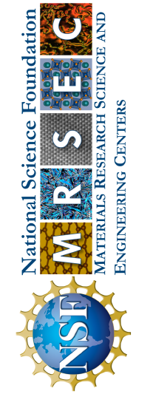
UC San Diego MRSEC
DMR-2011921
Discovery of bilayer nanoparticle (NP) superlattices using global Monte Carlo optimization
Yilong Zhou, Gaurav Arya, Duke University
What Has Been Achieved: IRG1 has developed a computational framework for understanding how nanoparticles (NPs) assemble at the interface between two immiscible fluids. These complex systems harness the competition between interparticle interactions and particle-interface interactions.
Importance of the Achievement: The resulting computational models enable the fast and accurate prediction of NP behavior, including the discovery of never-before-observed structures such as the bilayer NP superlattices shown here.
How is the achievement related to the IRG, and how does it help it achieve its goals? These models were inspired by the polymer-grafted NP systems studied in IRG1 and is currently guiding the experimental and characterization efforts of IRG1 for fabricating planar colloidal superlattices with distinct collective plasmonic, magnetic, optical, and electronic properties.
The Monte Carlo optimization approach (above) and schematic of two periodic honeycomb structures when hydrophobic and hydrophilic NPs are assembled at a liquid-liquid interface.
Nature Communications 2022, 13(1), 7976
Notes:
What Has Been Achieved: IRG1 has developed a computational framework for understanding how nanoparticles (NPs) assemble at the interface between two immiscible fluids. These complex systems harness the competition between interparticle interactions and particle-interface interactions. Using coarse-grained molecular dynamics (MD) simulations, the Arya group has demonstrated that binary systems of NPs (i.e., two NP populations) assemble into 2D superlattices when the NP species exhibit different miscibility with the fluids. They developed a basin-hopping Monte Carlo algorithm tailored for interface-trapped structures to rapidly determine the ground-state configuration of NPs. By varying the NP size ratio, interparticle interaction strength, and differences in NP miscibility with the two fluids, they demonstrated the assembly of an array of exquisite 2D periodic architectures, including AB-, AB₂-, and AB₃-type monolayer superlattices as well as AB-, AB₂-, A₃B₅-, and A₄B₆-type bilayer superlattices.
Importance of the Achievement: By analyzing particle arrangements in large-scale configurations, these models can be used to uncover a rich variety of mono- and bilayer NP superlattices. The resulting computational models can be used to make accurate prediction of ensemble nanoparticle behavior, including the validation of previously observed phases (networks, clusters, aerogels) and the discovery of new phases (bilayer superlattices, perforated sheets). The Arya group developed a tailored BHMC algorithm with a minimal amount of Monte Carlo moves to improve performance. The optimization approach, the assembly strategy, the understanding, and the structures discovered in this work all represent major advancements in the synthesis and discovery of 2D colloidal materials.
How is the achievement related to the IRG, and how does it help it achieve its goals? These results are guiding the experimental efforts of the Tao group for fabricating 2D colloidal superlattices with distinct collective plasmonic, magnetic, optical, and electronic properties.
Where the findings are published: Zhou, Y., & Arya, G. (2022). Discovery of two-dimensional binary nanoparticle superlattices using global Monte Carlo optimization. Nature Communications, 13(1), 7976. https://doi.org/10.1038/s41467-022-35690-8

