Slide 1
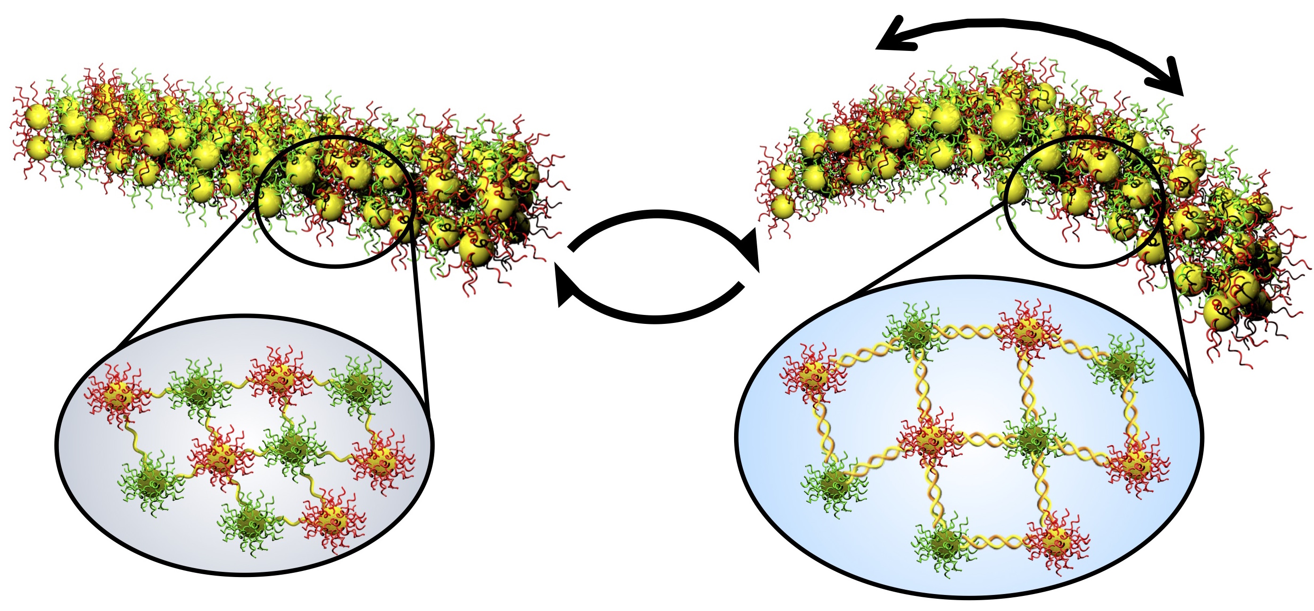
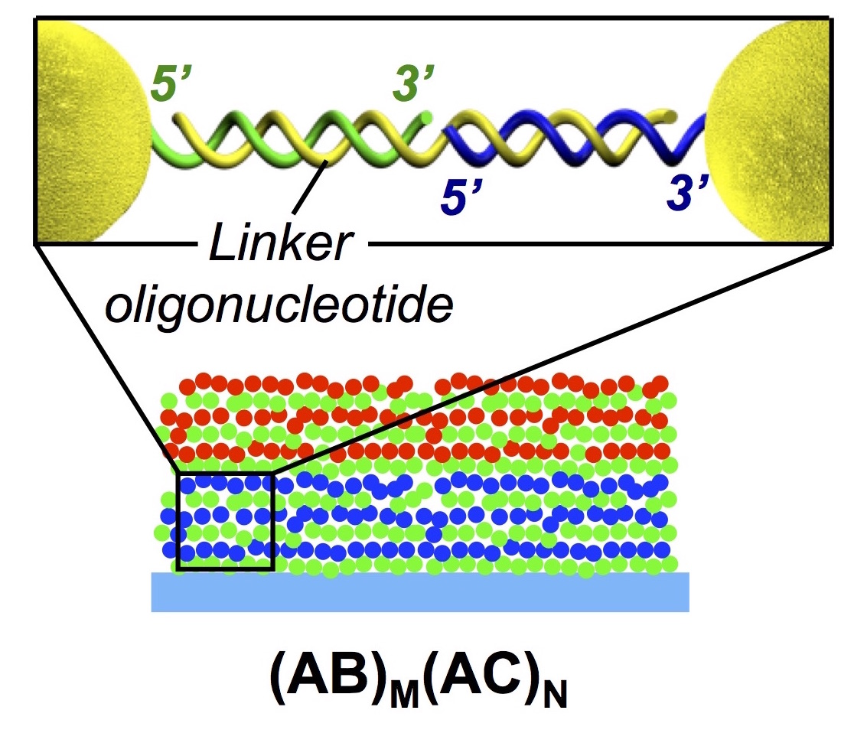
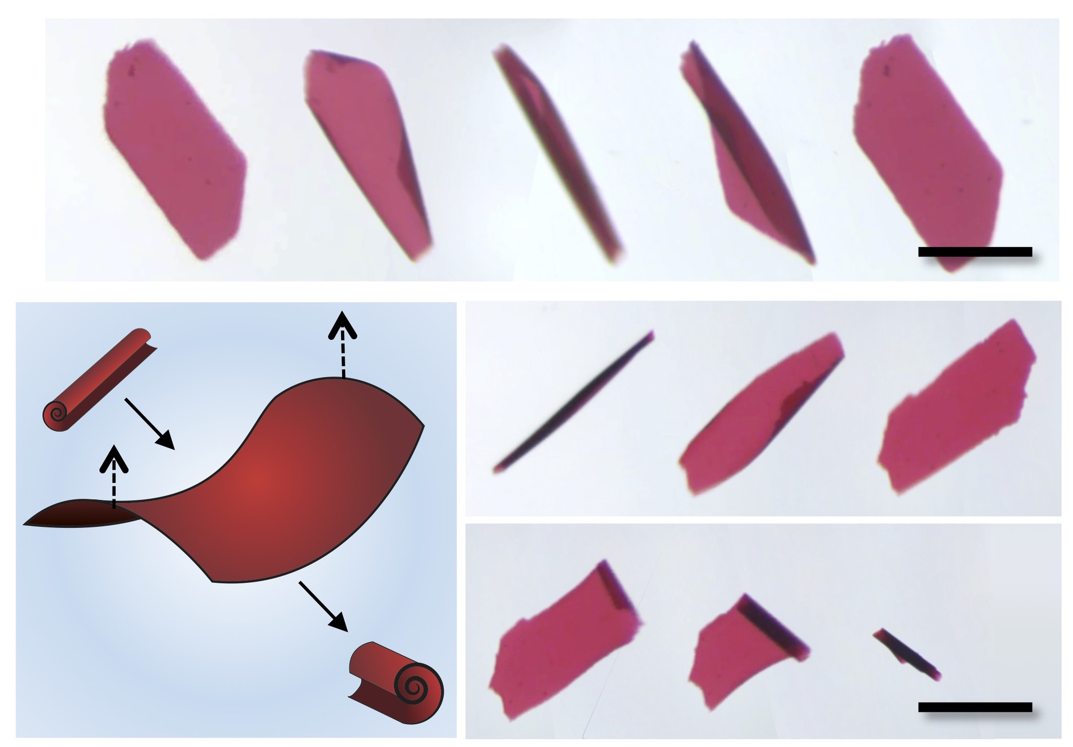
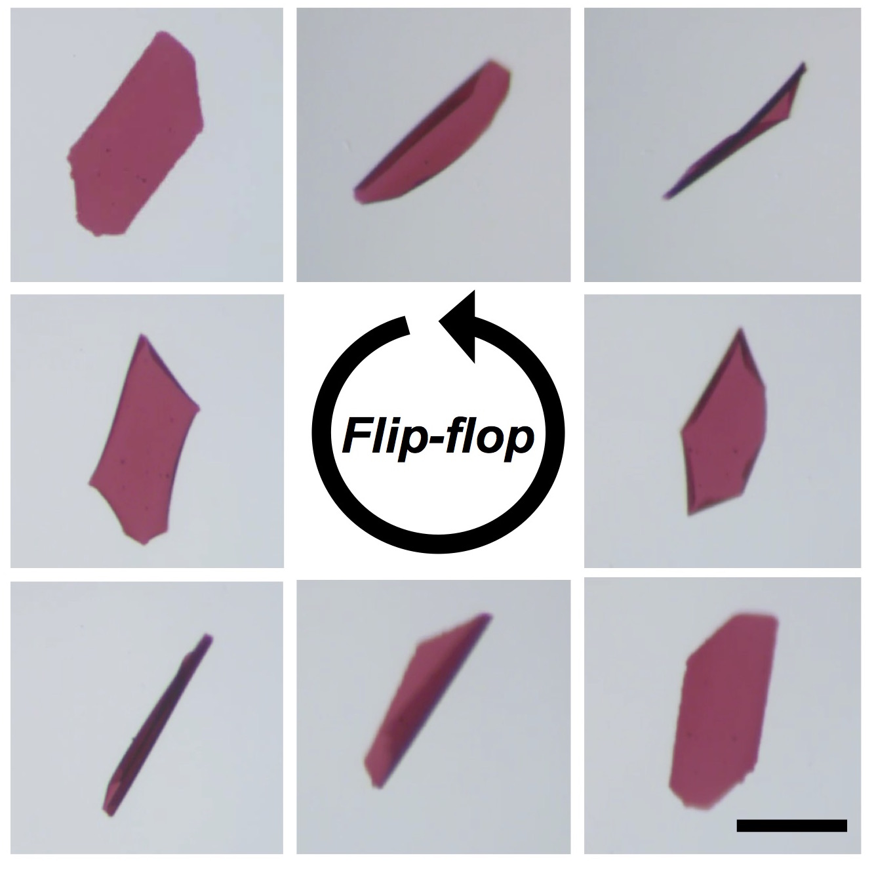
SEED Team Builds Simple Microrobots from DNA
NSF MRSEC DMR-11-20901
2016
TS Shim, D Chenoweth, D Lee, SJ Park, JC Crocker, Chemical
and Biomolecular Eng and Chemistry, U Pennsylvania
The ‘micro-origami’ approach to making microrobotic devices is to form thin films that can fold themselves into desired, dynamically transformable shapes. By combining photolithography, synthetic DNA and gold nanoparticles, MRSEC engineers created thousands of identical micromachines in water that can change their shape in seconds when commanded by the addition of other DNA strands to solution.¹ These machines, by curling and uncurling themselves, could roll over synchronously in a controlled manner; such that they all faced ‘up’ or ‘down’ on command. This operation required two independently controllable types of nanoscale DNA ‘muscles’, and would have been difficult or impossible with earlier micro-origami materials. In the future, these researchers hope to build more complex and capable microrobots to interface with biological systems.
a
b
c
d
(a) Gold nanoparticles are linked by DNA strands and form thin films. (b) Expanding the DNA strands on one side of the film causes curling. (c) 0.2 mm long films curl and uncurl in response to added DNA commands. (d) Films can be commanded to ‘roll-over’ repeatedly.
Shim TS et al. Dual-Addressable Shape Changing Thin Films Powered by DNA Hybridization,
Nature Nanotechnology, doi:10.1038/nnano.2016.192, 2016.
Notes:
Active materials that respond to physical and chemical stimuli can be used to build dynamic micro-machines that lie at the interface between biological systems and engineered devices. In principle, the specific hybridization of DNA can be used to form a library of independent, chemically-driven actuators for use in such micro-robotic applications and could lead to device capabilities that are not possible with polymer- or metal-layer based approaches. Here, we report shape changing films powered by DNA strand exchange reactions that have two different domains, which can respond to distinct chemical signals. The films are formed from DNA-grafted gold nanoparticles using a layer-by-layer deposition process. Films consisting of an active and a passive layer show rapid, reversible curling in response to stimulus DNA strands added to solution. Films consisting of two independently addressable active layers display a complex suite of repeatable transformations, involving eight mechano-chemical states and incorporating self-righting behaviour.
DNA nanoactuators can be designed to expand and contract by harnessing strand exchange reactions among DNAs and can be used to drive shape changes in films. To demonstrate such addressable chemical actuation, we produced thin films from DNA-grafted gold nanoparticle building blocks using a layer-by-layer (LbL) method, a substrate dipping process that adds roughly one monolayer of particles at a time⁹. We designed a small library of four different building blocks, each consisting of identical 12-nm gold cores bearing 4 different-sequence oligonucleotides grafted to their surface by thiol-Au bonds. To prevent unwanted competing reactions, oligonucleotides were designed to have minimal shared or complementary sequences among them. LbL fabrication of DNA-GNP films with multi-domain architectures is performed by a robotic dipper. Each film domain consists of alternating monolayers of two different DNA-GNPs whose oligonucleotides are hybridized with ‘linker’ oligonucleotides to form straight end-to-end bridges. This approach for forming DNA-GNP films is highly versatile, allowing many different film architectures to be made from the same building blocks by simply changing the linking strands and order of deposition.
We sought a two-state DNA nanoactuator that would be fast, strong and resistant to actuation by thermal fluctuations; this amounts to having a large free energy difference and a small difference in extension between the two states. Strand exchange hybridization has long been used for molecular level engineering of DNA-driven nanostructures such as programmable colloidal self-assembly, optical switches, and molecular machines. We took advantage of a simple toe-hold strand exchange hybridization scheme, where the two states are simply a single stranded gap in the linker strand, and that same gap hybridized with a soluble strand. The use of a dangling handle facilitates strand removal, both energetically, and also kinetically by promoting the strand exchange reaction. Specifically, we designed a Linker DC strand having 15 extra bases added to its middle, forming the single stranded ‘gap’ in the bridge. A 24 base Filler DC strand with a 9 base long handle hybridizes with the gap sequence, resulting in a slight increase in the length of the nanoactuator complex, and corresponding swelling of the film. The Filler DC strand is removed by the addition, in excess, of a Stripper DC strand that is complementary to Filler DC over its entire 24 base length.
To function properly, it is imperative that the three actuation strands do not form any undesirable complexes with each other or any of the other DNA strands in the entire film system. This screening was performed using multi-oligonucleotide simulations in NUPACK, at concentrations relevant for the crowded conditions in the film (~10 mM oligonucleotide concentrations); while thermodynamic parameters for solution are likely not accurate for the film state, these calculations suffice for screening during the design process. To monitor the changes in film thickness in situ, we conducted ellipsometry measurements of a wet (DC)₁₀ film immersed in a buffer. The film had average thickness with 333 nm in the presence of Filler DC, whereas it was 300 nm without Filler DC. Regarding dimensions of DNA-GNP film, this ~10% swelling should suffice to drive significant shape change in free-standing films. Complementary experiments on free-standing homogeneous (DC)₁₀ showed 15% areal expansion. A similar set of three strands were designed and screened to actuate films formed of (AC)_{n}, Linker AC, Filler AC and Stripper AC.
Our dual addressable films obviously have four distinct chemical states, corresponding to each domain being separately in the expanded or contracted state. Experiments reveal that each chemical state has two stable mechanical states of essentially identical energy: flat films may simply have either of the two domains facing upward, while curled films can curl either along the long-axis of the film rectangle or along the short axis. We find that the films can be reliably driven around this operational space of 8 mechano-chemical states. This operational space allows the films to be ‘righted’, i.e. they will flip over in a manner dependent on their initial mechanical state, due to competition between DNA free energy, bending energy, diffusion-limited transport and gravity. Following four consecutive DNA strand additions (Stripper AC, Filler AC, Stripper DC, Filler DC), films will end up in a flat state with their DC domains facing upwards, independent of the starting orientation. Simply reversing the order of strand addition will result in the films again in a flat state, but with their AC domains facing upwards.
In summary, we find that embedded DNA nanoactuators are able to power rapid shape changing in thin-film devices made of DNA-GNPs. All sequences could be designed, screened computationally and then worked as expected according to DNA thermodynamics. Shape changing films with dual chemical addressability were demonstrated, and displayed an operational diagram that is robot-like in its complexity and sensitivity to order of operations. By spatially controlling the active domain on DNA-GNP films, independent and sequential actuations can be realized which is a key for robotic actuation and building complex 3D objects. Beyond what we demonstrate here, DNA nanoactuators can be applied to versatile materials such as DNA-conjugated organic- or inorganic colloids, or hydrogels. Moreover, a film composed of DNA-conjugated anisotropic colloids can have unique mechanical characteristics that will broaden the possible range of actuation. We believe that our approach can solve challenging issues of temporal and spatial manipulation in microactuation and soft robotics in the future.

Slide 2
SEED Team Builds Simple Microrobots from DNA
NSF MRSEC DMR-11-20901
2016
PIs: D Chenoweth, D Lee, SJ Park, T Sinno, JC Crocker, Chemical
and Biomolecular Eng. and Chemistry, U Pennsylvania
Overall, this SEED project has supported the training of three postdoctoral scholars and three Ph.D. students in the engineering of state of the art nanomaterials formed by a combination of directed self-assembly and novel photolithography methods.
Dr. Tae Soup Shim led the experimental effort to produce simple DNA-powered microrobots, requiring interdisciplinary training in nanoparticle chemistry, DNA nanotechnology and advanced photolithography methods. He is now an Assistant Professor of Chemical Engineering, Ajou University, Korea.
Dr. Mehdi Zanjani led theoretical efforts to understand directed self-assembly in general, and the operation of the DNA-powered microrobots in particular, relying on training in multi-scale modeling, DNA nanotechnology, solid mechanics and statistical mechanics. He is now Assistant Professor of Mechanical and Manufacturing Engineering, Miami University, Ohio.
Dr. Tae Soup Shim
Dr. Mehdi Zanjani

