Slide 1
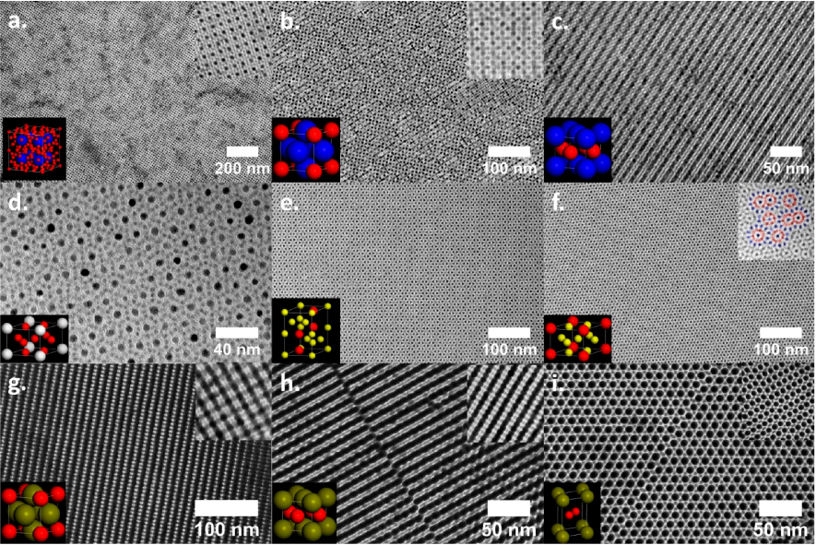
Polycatenar Ligands Control Nanocrystal Synthesis and Self-Assembly
NSF MRSEC DMR-11-20901
2016
Penn-COMPASS
Partnership:
Diroll, Jishkariani, Cargnello, Murray (University of Pennsylvania), Donnio (CNRS)
IRG-4
IRG-4 creates new forms of matter by assembling nanometer-sized crystals into large, ordered, complex assemblies (nanocrystal superlattices.
Murray (IRG-4) and Donnio (CNRS) have synthesized a library of molecules (polycatenars) that enable new kinds of nanocrystals and superlattices.
Examples of new nanocrystal superlattices made possible by polycatenar ligands.
Diroll, Jishkariani, Cargnello, Murray, Donnio, J. Am. Chem. Soc. 2016,138, 10508-10515.
Notes:
Technical note: These superlattices involve assembly of two different kinds of nanocrystals (thus, binary superlattices), and many shown include two different kinds of ligands. These new ligands are enabling synthesis of metallic, chalcogenide, pnictide, oxide and rare-earth nanocrystals, greatly expanding the “periodic table” of nanocrystals that one can draw from. Additionally, the ligands are able to tune the NC-NC interaction from hard sphere to “soft” sphere, which then changes the superlattice crystal structure.

Slide 2
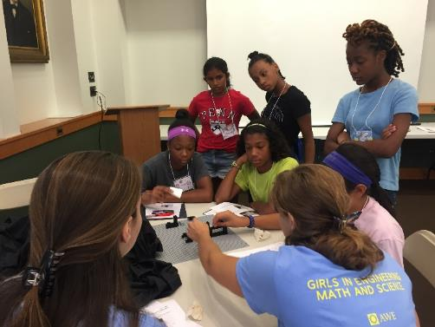
Lego Optics Lab @GEMS Summer Camp
NSF MRSEC DMR-11-20901
2016
C. Kagan, University of Pennsylvania
The Kagan (IRG-4) group created a Lego Optics lab for Penn’s Girls in Engineering, Math and Science (GEMS) summer camp for 6th-8th grade girls.
Middle school girls learn about the reflection, refraction, polarization, and diffraction of light hands-on. Lego is used to build mounts for light sources, optical elements, and detectors and the interaction of light with matter.
MRSEC undergraduates Lizzy Dresselhaus and Natasha Iotov demonstrate diffraction of light to 6th-8th grade middle school girls participating in the Girls in Engineering Math and Science (GEMs) summer camp. (Kagan)

