Slide 1
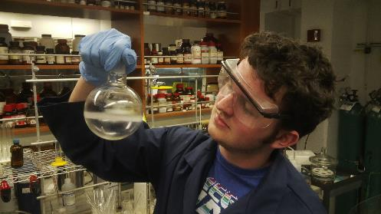
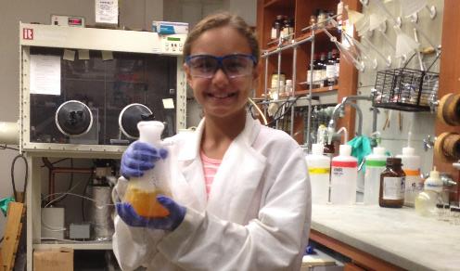
MRSEC-Related Research by High School Students
NSF MRSEC DMR-11-20901
2016
V. Percec, M. Kozlowski, D. Durian, A.R. McGhie &
M.W. Licurse, University of Pennsylvania
For many years now, MRSEC-affiliated faculty have accepted high school students into their labs during the summer, or on weekends during the semester, to undertake research projects that are supervised by a post-doctoral scholar or a senior graduate student. Student selection is made by the faculty member, who is responsible for the student during the program, and students first undertake safety training with EHRS. The number of students chosen for this program has been increasing: 10 in 2013, 17 in 2014, 16 in 2015, 19 in 2016. Following high school, almost all students have entered STEM program in college with many going to top schools. Interestingly, since 2014, six of our HS students have been co-authors on archival publications. They are: Ariel Kinghoffer, Central HS, Phila., who co-authored a paper with Prof. M. Kozlowski, Chemistry, in J.A.C.S. 136 30 10601-10604 (2014); Nicholas Gutsche, Charter School of Wilmington, Aleksander K. R. Pesti, Pennsbury HS, and James T. Olsen, LaSalle College HS, co-authored a paper with Prof. V. Percec, in Organic Letters 16 24 6326-6329 (2014); Jack Rubien, also published a paper with Prof. Percec, J.A.C.S. 138:38 12655-12663 (2016); Nicholas Meysingier, Strathhaven HS, published a paper with Prof. D. Durian, Physics, Papers in Physics, vol. 6, art. 060009 (2014.) It is very unusual for a high school student to co-author a paper and it only happens if the adviser decides that the student's work merits inclusion.
Jack Olsen (top) and Nina Zimakas (bottom)

