Slide 1
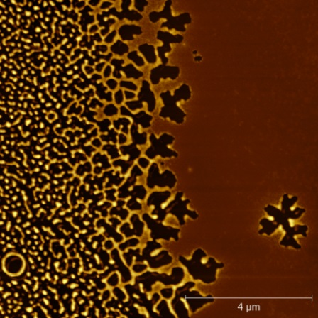
Intellectual Merit: Long correlation length for glassy dynamics
NSF MRSEC DMR-11-20901
2016
Zahra Fakhraai, Karen Winey, and Robert Riggleman
University of Pennsylvania
Measuring correlated dynamics in molecular glasses: Properties of molecular glasses change as they are made into nanometer sized films. Fakhraai and Riggleman showed that when the film thickness is reduced below 30 nm, the solid glass films become liquid-like and flow. This results in dewetting as shown in the figure.
Fakhraai and Riggleman studied correlation lengths in glassy systems using isothermal dewetting of thin films of molecular glasses along with glass transition temperature measurements. They showed that similar properties are observed in various polymeric films as well as inorganic glasses such as amorphous selenium (in collaboration with Richard Stephens).
[1] Yue Zhang, Ethan C. Glor, Mu Li, Tianyi Liu, Kareem Wahid, William Zhang, Robert A. Riggleman, and Zahra Fakhraai. "Long-range correlated dynamics in ultra-thin molecular glass films." The Journal of Chemical Physics 145, 11 (2016): 114502.
Dewetting pattern of an organic glass thin film with a gradient of thickness. Thickness increases from left to right, resulting in a dramatically slower dewetting rate when the film is held at T_{g}-12 K.
Notes:
Molecule used in this study is N,N 0-Bis(3-methylphenyl)-N,N 0-diphenylbenzidine (TPD) with a glass transition temperature of 308 K. The isothermal dewetting measurement is shown at T_{g}-12 K.

Slide 2
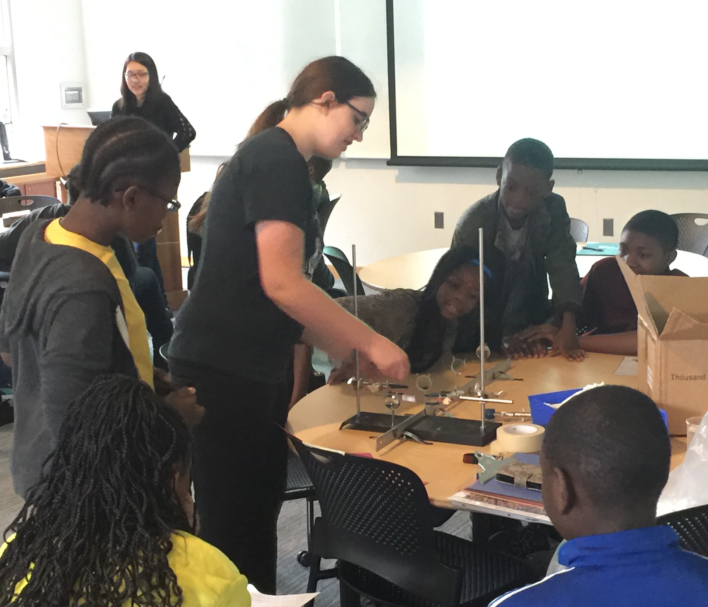
Broader Impact
NSF MRSEC DMR-11-20901
2016
Zahra Fakhraai, Karen Winey, and Robert Riggleman
University of Pennsylvania
Girard College National Society of Black Engineers: Fakhraai group members Melissa Vettleson, Sarah Wolf, and Tiany Liu, along with undergraduate student Gabriel Angrand (organizer of the event and Pre-College Initiative Chair of Penn’s National Society of Black Engineers) participated in hands-on experiments and demonstration for high-school students. “This STEM Conference acts as a vehicle for middle school and high school members in the surrounding community to get exposure to the lab settings, practical experiments, scientific reasoning and procedure in collegiate institutions and generally begin thinking about opportunities they can pursue in their post high school paths".
Graduate student Sarah Wolf demonstrates optical cloaking to Philadelphia high-school students at an event organized by the National Society of Black Engineers.
Notes:
The seed members have participated in various outreached events organized by MRSEC and other institutions. These events include Science After Hours event at the Franklin Institute, Nonoday@Penn, Philadelphia Science Festival, and Girard college National Society of Black Engineer.

