Slide 1
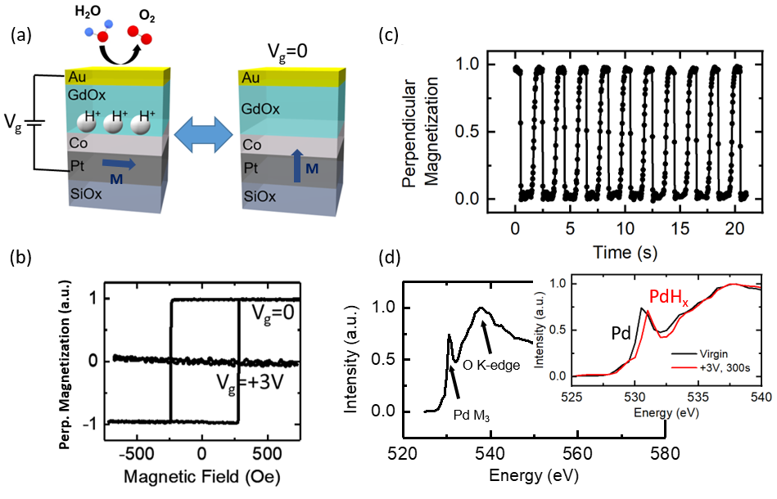
IRG-III Electrical control of magnetic properties in thin films by hydrogen gating
MIT MRSEC
DMR 14-19807
2018
INTELLECTUAL MERIT
Controlling magnetism using a gate voltage could enable new classes of low-power memory, logic, and sensing technologies. In ultrathin magnetic films, the orientation of the magnetization can either be in the plane of the film or perpendicular to the film, depending on the nature of the interface, which determines the sign of the magnetic anisotropy. Here, we discover that in thin Pt/Co/GdOx/Au layered structures, where all materials have thicknesses of the order of nanometers, the magnetization can be toggled between in-plane and out-of-plane states using a small applied voltage.
The mechanism was discovered to arise from electrochemical water splitting at the Au/air interface, which can be used to inject protons into the material and toward the magnetic thin film to switch its magnetic properties. Since hydrogen can also be injected into heavy metals like Pt and Pd, a whole host of spin-orbit phenomena can be gated electrically, which cannot be achieved by any other means.
Geoffrey Beach, Harry Tuller
Massachusetts Institute of Technology
(a) Schematic of layered structure, where a gate voltage V_{g} splits water and injects protons (H⁺) toward the magnetic cobalt (Co) layer. The magnetization (M) switches between in-plane and out-of-plane depending on the presence or absence of protons, as seen in the hysteresis loops of (b). The magnetization orientation can be switched reversibly as the voltage is toggled (c), for thousands of cycles with no device degradation. X-ray absorption spectroscopy was used to verify the presence of hydrogen in a Pd sensing layer (d).
Tan, A. J., Huang, M., Avci, C. O., Büttner, F., Mann, M., Hu, W., Mazzoli, C., Wilkins, S., Tuller, H. L., and Beach, G. S. D. “Magneto-Ionic Control of Magnetism Using a Solid-State Proton Pump.” Nature Materials, 18(1): 35–41, 2019. <doi:10.1038/s41563-018-0211-5>

Slide 2
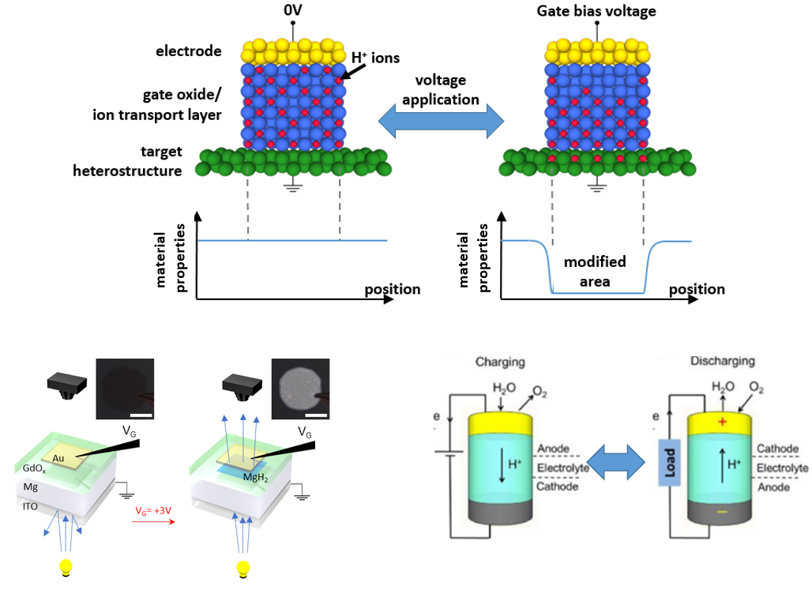
IRG-III Electrical control of magnetic properties in thin films by hydrogen gating
MIT MRSEC
DMR 14-19807
2018
Geoffrey Beach, Harry Tuller
Massachusetts Institute of Technology
BROADER IMPACTS
The properties of materials at the nanoscale are often determined by the chemical, electronic, and defect structure at interfaces. The possibility to dynamically control interfacial properties of materials using an electrical voltage opens the door to reconfigurable materials with a variety of functions.
This work has uncovered a simple, broadly applicable means to control materials properties by harvesting hydrogen from the air, using water in the form of humidity as a source. A small applied voltage can inject or remove hydrogen from a material, to control electrical, magnetic, or optical properties, and even to store energy in the material at the same time.
Top figure: schematic of hydrogen pumping being used to modulate properties of thin films. Bottom left: hydrogen sourced from water in the air is used to switch a thin magnesium layer from a metal to a transparent metal-hydride. Bottom right: stored hydrogen in the material gives rise to a battery-like effect, making these devices similar to solid oxide fuel cells with integrated hydrogen storage. Hence, energy harvesting and storage could be integrated into nanoscale devices with optical, magnetic, or electronic functions.
Tan, A. J., Huang, M., Avci, C. O., Büttner, F., Mann, M., Hu, W., Mazzoli, C., Wilkins, S., Tuller, H. L., and Beach, G. S. D. “Magneto-Ionic Control of Magnetism Using a Solid-State Proton Pump.” Nature Materials, 18(1): 35–41, 2019. <doi:10.1038/s41563-018-0211-5>

