Slide 1
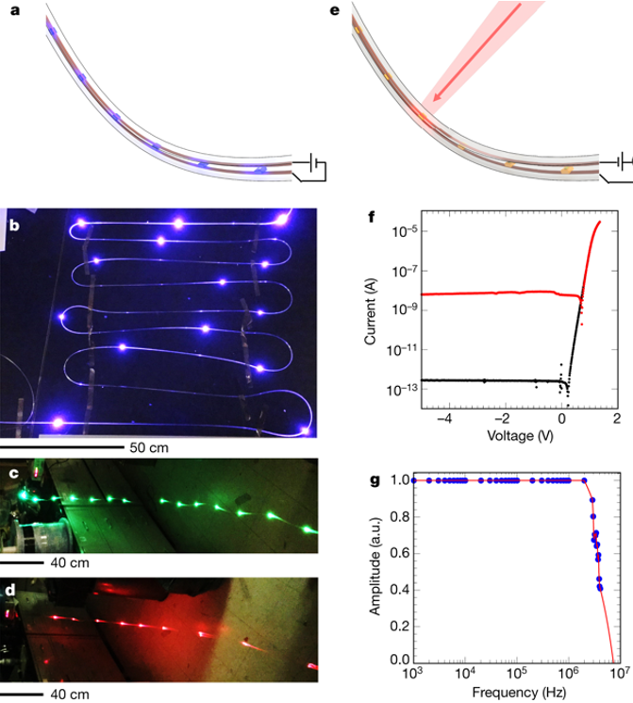
IRG I: Diode Fibers for Fabric-based Optical Communications
MIT MRSEC
DMR 14-19807
2018
INTELLECTUAL MERIT
Semiconductor diodes are fundamental building blocks of modern communications and sensing. Thus, incorporating them into fibres can increase fabric capabilities and functions. However, current material and processing challenges have impeded the realization of high-performing semiconducting diodes in thermally drawn fibres. Here we demonstrate a scalable thermal drawing process of electrically connected diode fibres. Hundreds of commercial device-grade diodes are first embedded in the preform. During the thermal draw, wires are fed into the preform, and as the preform necks into a fiber, the wires and devices converge together within the fiber to make hundreds of parallel electrical connections in a single draw. The resultant electrically-connected diode fibers are shown to emit light of the 3 primary colours and detect light to a high photosensitivity and bandwidth. These results provide a path towards ever-increasing functions in fiber, presenting the prospect of a fiber ‘Moore’s law’ analogue.
John Joannopoulos and Yoel Fink
Massachusetts Institute of Technology
(a) Schematic of the light-emitting fiber. Wires (orange) are connected to the LEDs (purple). Photograph of light-emitting fibers containing (b) InGaN blue-colour LEDs, (c) InGaN green LEDs, (d) AlGaAsP red LEDs. (e) Schematic of the photodetecting fiber structure, where an individual photodiode (orange) detects external light (red arrow). (f) Current–voltage curve of photodetecting fiber, showing clear rectifying behaviour. Black curve: in darkness. Red curve: under illumination. (g) Bandwidth of the photodetecting fibre. The 3 dB bandwidth achieved is around 3 MHz. a.u., arbitrary units.
Rein, M., Favrod, V. D., Hou, C., Khudiyev, T., Stolyarov, A., Cox, J., Chung, C.C., Chhav, C., Ellis, M., Joannopoulos, J., Fink, Y. (2018). “Diode fibres for fabric-based optical communications. ”Nature,560 (7717), 214-218. <doi:10.1038/s41586-018-0390-x>

Slide 2
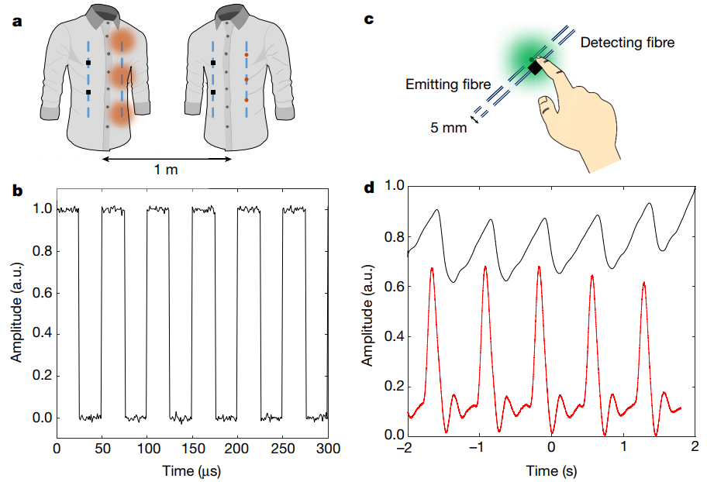
Diode Fibers for Fabric-based Optical Communications
MIT MRSEC
DMR 14-19807
2018
BROADER IMPACT
Technological output/Applications: The practicality of these diode fibers for real-life applications is supported by its flexibility to be woven into a fabric and its ability to be washed through 10 cycles without any performance degradation. Some applications of these fibers include bidirectional communications from person to person between the fibers-woven fabrics, and physiological purposes, where the light-emitting and light-detecting fibers woven side by side in a fabric can be used to monitor heartrate through the blood vessels in the finger. Collaboration: This work was done in collaboration with an international Masters student intern from EPFL (Switzerland), with a Research Scientist from Lincoln Laboratory, and 4 textile industrial employees from AFFOA (Advanced Functional Fabrics of America). Translation to products: This work was patented and the basic research of these semiconducting fibers has been translated into industrial developments in AFFOA (Advanced Functional Fabrics of America), where new products based on these diode fibers are being realized and will be marketable soon.
Massachusetts Institute of Technology
(a) Light-emitting and light-detecting fibers are woven into two fabrics. (b) Light pulsation in one fabric can be detected by another fabric, hence establishing a 1 meter long bidirectional communication between person to person. (c) These fibers are also woven side by side in a fabric to enable (d) heartrate monitoring through light reflectance measurement of the blood circulation in the finger. Black curve represents the data from the fibers while the red curve represents that from a commercial sensor.
Rein, M., Favrod, V. D., Hou, C., Khudiyev, T., Stolyarov, A., Cox, J., Chung, C.C., Chhav, C., Ellis, M., Joannopoulos, J., Fink, Y.. “Diode fibres for fabric-based optical communications.” Nature,560 (7717): 214-218. 2018. <doi:10.1038/s41586-018-0390-x>

