Slide 1
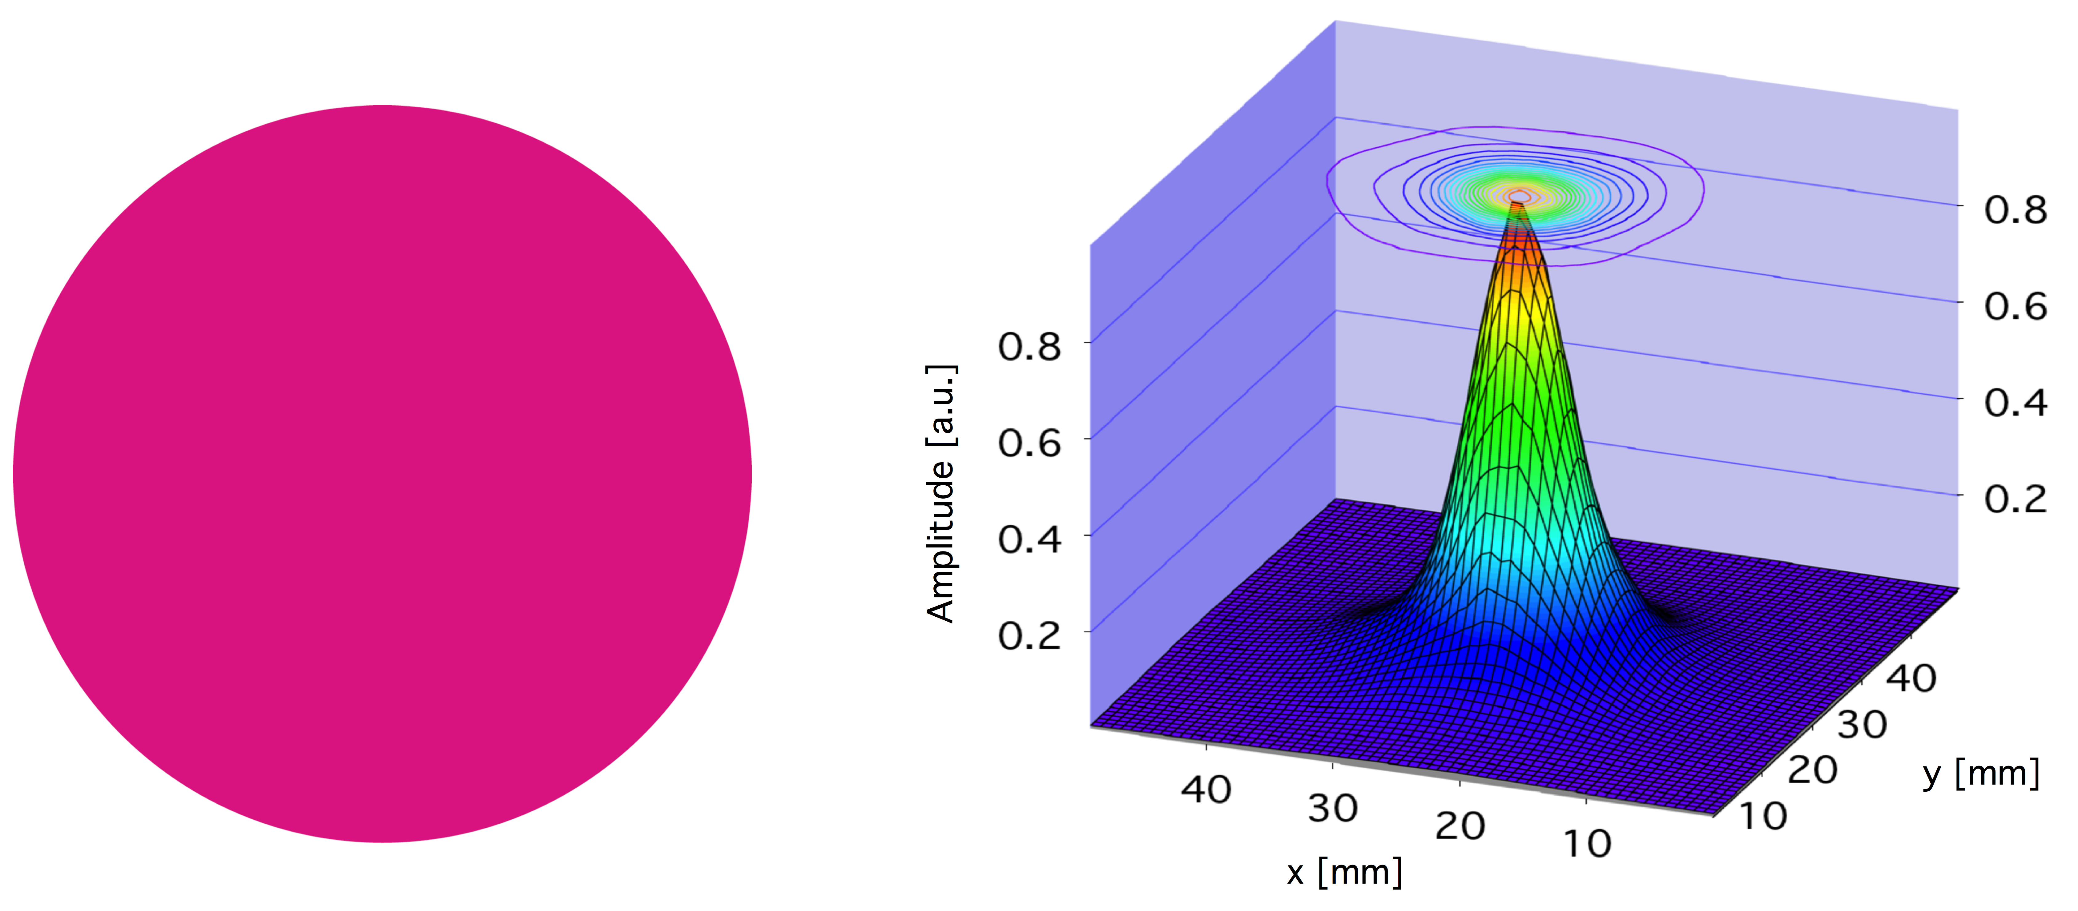
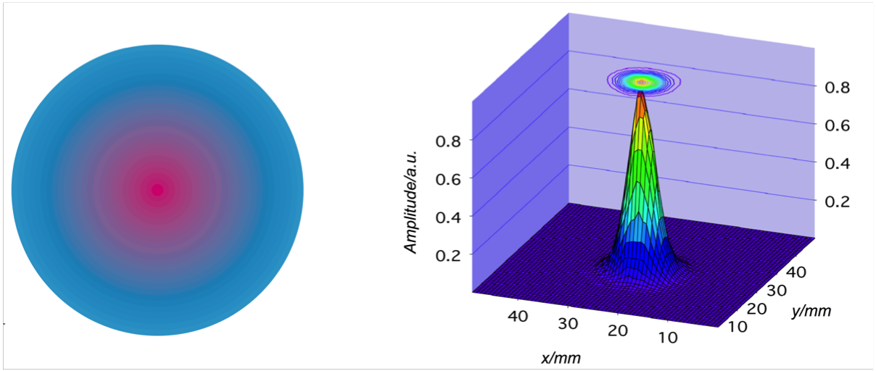
Terahertz Plasmonic Structures with Spatially Varying Conductivity
Barun Gupta, Shashank Pandey, Sivaraman Guruswamy and Ajay Nahata
Objective: Develop plasmonic structures in which the spatial conductivity can be varied
Approach: Use a commercial inkjet printer with conductive silver ink and resistive carbon ink filled in separate cartridges. Use conventional presentation software to design and print plasmonic structures with desired spatial variation.
Results and Significance: Using THz imaging, we measured the changes in the transmitted beam profile as a function of the spatial conductivity pattern. Results demonstrate that the change in conductivity corresponds directly to changes in surface plasmon polariton propagation lengths, yielding additional flexibility in creating new plasmonic structures.
Top Left: Periodic hole array (not shown) printed using pure silver ink (magenta corresponds to 100% silver ink). Top Right: Corresponding transmitted THz beam profile. Bottom Left: Periodic hole array printed radially varying conductivity (cyan corresponds to 50% silver ink, 50% carbon ink). Bottom Right: Corresponding transmitted THz beam profile
Advanced Optical Materials, 2014, Early View Online Publication

