Slide 1
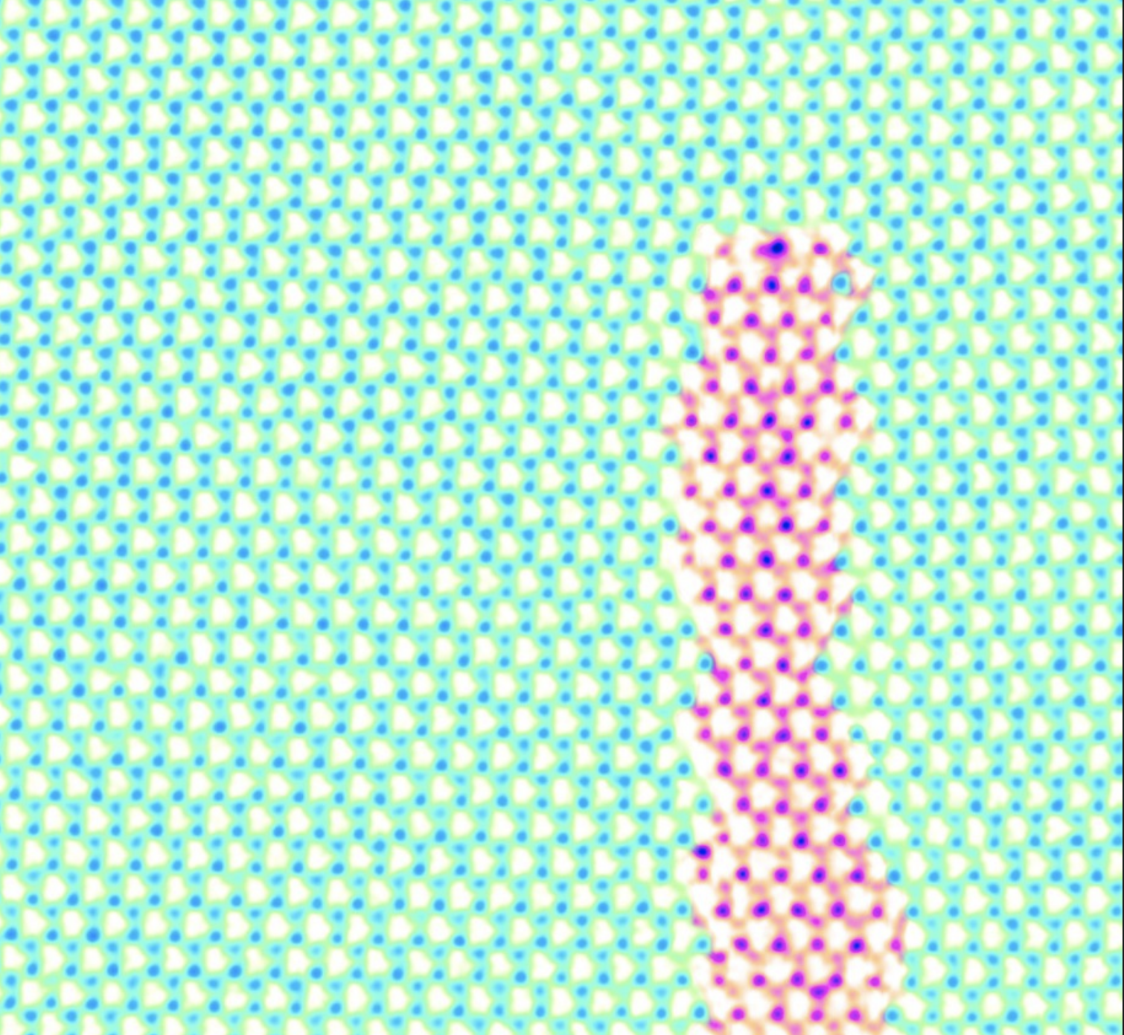
Threading atom-wide wires into 2D materials
MRSEC DMR-1719875
2018
Cornell Center for Materials Research: an NSF MRSEC
Cornell University researchers and collaborators have discovered – somewhat accidentally – a method for inserting a one-dimensional (1D) semiconductor channel into the “fabric” of a material that is only a few atoms thick.
Two-dimensional (2-D) materials such as molybdenum disulfide (MoS₂) and tungsten diselenide (WSe₂) can be likened to two fabrics with differing thread counts. Where two different fabrics meet, not all the threads line up. The “loose threads” are easily removed and replaced with a new colored thread woven cleanly into the material – these are new 1 D wires.
The ability to control atom-sized features (1-D wires) and the properties of those features (conductivity and semi-conductivity) hold great promise for next-generation electronics such as atomically-thin and flexible computer chips.
Electron microscope image of a 1-D channel of molybdenum disulfide embedded in 2-D tungsten diselenide. The blue/green dots are tungsten and selenium atoms; the magenta dots are sulfur atoms. The entire film is three atoms thick.
Y. Han et al., Nature Materials 17, 129-133 (2018)

Slide 2
Please enter Title here
Please enter DMR Program and award number here
2016
Please enter Name and University here
Please submit a separate Highlight for each DMR-funded project. Highlights should consist of two slides, one on Intellectual Merit and one on Broader Impacts. Please use only .pptx or .ppt format (not .pdf or .doc).
Please describe on this slide a major accomplishment from your research in the current year of your grant. Make sure to use language comprehensible by non-experts. Start with a sentence on the general context of this work and conclude with one on why it is important. If you wish, you may also append at the bottom a reference or two.
Since the text on the slide is brief and intended for non-experts, feel free to add under Notes (below) a more technical description of the accomplishment for use by DMR Program Directors.
Please insert one or more images here. If you need more space, you may reduce the adjacent textbox. Please use lettering that is not too small. You could also insert chemical or mathematical formulas, molecular models, etc. Visually appealing images that can be appreciated by non-experts are most desirable, but feel free to use whatever is appropriate. Please include a very brief caption for the figures.
Very Important: New regulations require entering also “Alternative Text” for each image or other object to make them accessible to people with visual disabilities. Please see instructions on attached file for how to do that.

