Slide 1
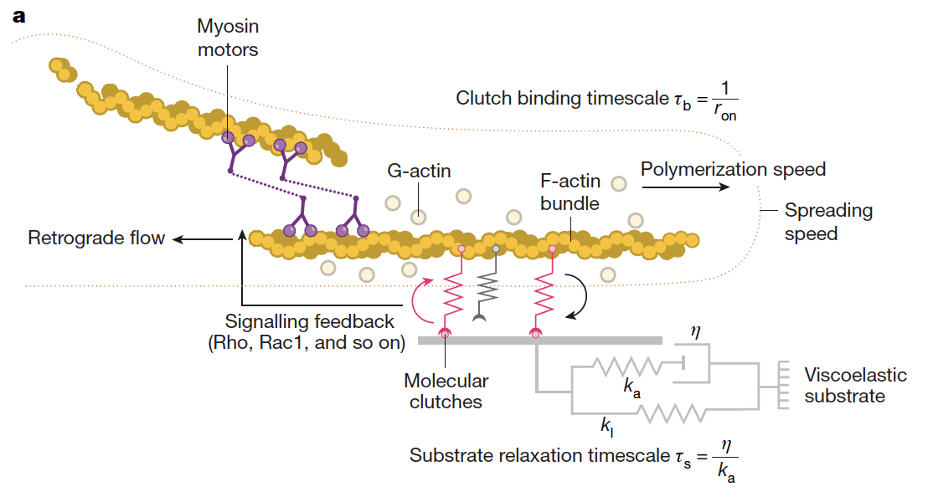
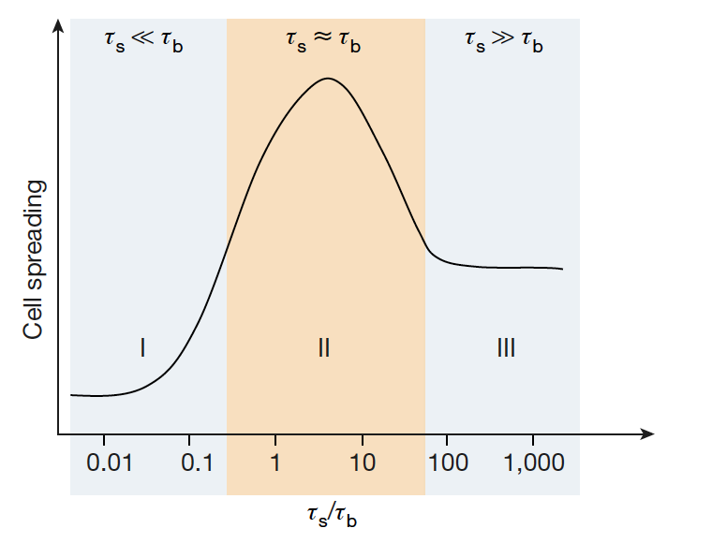
Effects of extracellular matrix viscoelasticity on cellular behavior
DMR: 1720530
2021
Linearly elastic elastomers coated with matrix proteins are widely used to assess the role of stiffness. Such experiments are often assumed to reproduce the effect of the mechanical environment experienced by cells in vivo.
However, tissues and the extracellular matrix (ECM) are not linearly elastic materials. They exhibit far more complex mechanical behaviors. These behaviors include viscoelasticity, as well as mechanical plasticity, and nonlinear elasticity.
Our theoretical and experimental work has revealed that matrix viscoelasticity regulates fundamental cell processes and can promote behaviors – such as proliferation, motility and spreading – that are not observed with elastic hydrogels in both two- and three-dimensional culture microenvironments.
These results suggest design guidelines for the next generation of biomaterials, allowing us to match tissue and ECM mechanics to create in vitro tissue models and to enable applications in regenerative medicine.
Paul Janmey, Vivek Shenoy, University of Pennsylvania
The molecular clutch model (top) of mechanotransduction explains the effect of matrix viscoelasticity on cell spreading. Simulations predict optimal cell spreading when the timescale for stress relaxation (τ^{s}) is similar to the clutch binding timescale (τ_{b}).
O. Chaudhuri, J. Cooper-White, P. A. Janmey, D. J. Mooney, V. B. Shenoy, Effects of Extracellular Matrix Viscoelasticity on Cellular Behavior, NATURE, 584: 535-546, AUGUST 2020
Notes:
O. Chaudhuri, J. Cooper-White, P. A. Janmey, D. J. Mooney, V. B. Shenoy Effects of Extracellular Matrix Viscoelasticity on Cellular Behavior NATURE, 584: 535-546, AUGUST 2020

