Slide 1
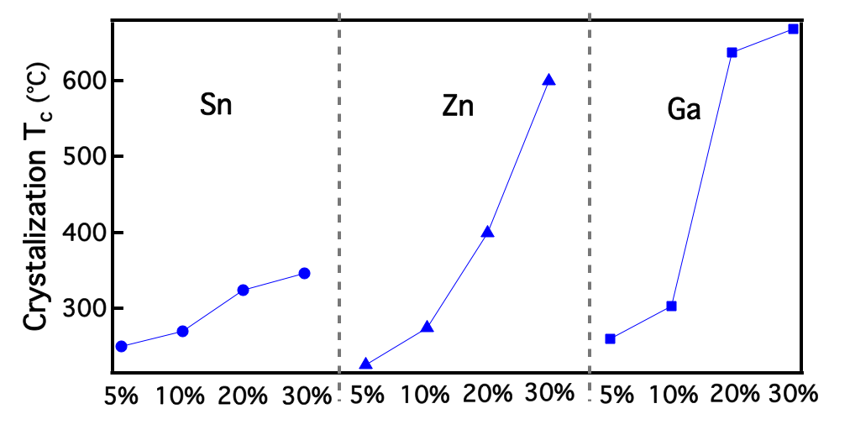
X-ray Scattering Study of Thermally-Induced Amorphous-to-Crystalline Transition for In-X-O Films
Li Zeng¹, M. Moghadam¹, D. Buchholz¹, D. Keane³, Tobin J. Marks^{1,2}, Robert Chang¹, Peter Voorhees¹, Michael J. Bedzyk¹
¹Materials Research Science & Engineering Center, Northwestern University
²Department of Chemistry, Northwestern University
³Northwestern University Synchrotron Research Center
2D detector
Scattered X-ray
Amorphous metal oxides (AMOs) have been a potential key channel-layer material in the fabrication of thin film transistors for future electronic applications. This work particularly focuses on the thermal stability of In₂O₃ based thin films. Hence, a series of In-X-O thin films has been deposited by pulsed laser deposition (PLD). “X” (Sn, Zn, and Ga) is the doping element to In₂O₃, and each dopant has four atomic percentage: 5%, 10%, 20% and 30%. In situ grazing incidence wide angle X-ray scattering (GIWAXS) technique and level-set simulation have been employed to characterize and model their amorphous to crystalline transition.
Incident X-ray
Sample
Schematic of GIWAXS measurement.
Crystallization temperatures of In-X-O thin films
Advanced Materials 27, 2390-2399 (2015).
NSF-MRSEC DMR-1121262

