Slide 1
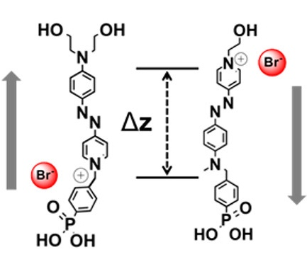
Controlling Dielectric Polarization via Molecular Design
NSF-MRSEC DMR-1121262
IRG-1, Northwestern University MRSEC
Dielectric materials play a critical role in determining the operating voltage in modern-day electronics. In particular, highly polarizable and ultrathin dielectrics enable low operating voltages and thus low power consumption. A particularly promising class of materials that meet these requirements are self-assembled nanodielectrics. These organic-inorganic hybrid dielectrics exhibit exceptionally large capacitances, low leakage currents, and solution processability in ambient conditions while being only a few nanometers in thickness. The organic components of these nanodielectrics have the additional advantage that they can be tailored through organic synthesis. In this study, this synthetic flexibility was utilized to generate two molecules with virtually identical structure except for an inverted dipole direction. This work thus elucidated the role of the molecular dipole in the overall capacitive properties of self-assembled nanodielectrics.
ACS Appl. Mater. Interfaces, 10, 6484 (2018).
Design of the two self-assembled molecular dielectrics used in this study. The orientation of the molecular dipole is inverted between the two cases, allowing control over dielectric polarization.
Notes:
For more details, please see the following publication: L. Zeng, R. Turrisi, B. Fu, J. D. Emery, A. R. Walker, M. A. Ratner, M. C. Hersam, A. F. Facchetti, T. J. Marks, and M. J. Bedzyk, “Measuring dipole inversion in self-assembled nano-dielectric molecular layers,” ACS Appl. Mater. Interfaces, 10, 6484-6490 (2018).
This project is a multi-PI collaboration involving Mark Ratner, Mark Hersam, Tobin Marks, and Michael Bedzyk of Northwestern University MRSEC IRG 1.

