Slide 1
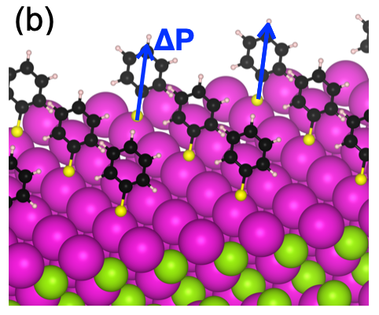
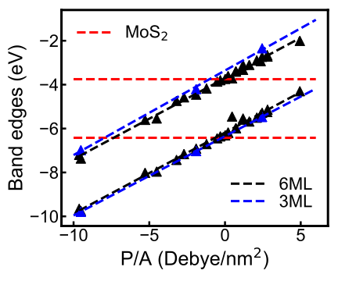
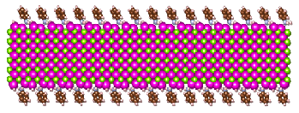
Interlayer Tuning of Electronic Band-Offsets in Mixed-Dimensional Heterojunctions
NSF DMR-1720139
2020
IRG-1, Northwestern University MRSEC
Most inorganic quantum dots (QD) are obtained through organic synthesis using surface ligands. When deposited on two-dimensional (2D) materials such as MoS₂, such ligands form an “interlayer” between the components of the resulting mixed-dimensional heterojunction. To understand the effects of this interlayer, a collaborative theory and experimental effort in NU-MRSEC IRG-1 effort has modeled and characterized the electronic structure of CdSe nanoplatelets (NPLs) with well-controlled ligand-dipole terminations. The electronic band-offsets of these NPL/MoS₂ heterojunctions are found to be strongly impacted by the ligand areal dipole, with continuous tunability for commonly used ligands. This scheme can be used to design optical excitations over a broad energy range in mixed-dimensional heterojunctions.
(Left) CdSe nanoplatelets (NPLs) are deposited on MoS₂ through a dipolar ligand interlayer. (Right) Computed band-offsets between NPLs and MoS₂ for a 3 monolayer-thick (3ML) platelet and a 6-monolayer-thick (6ML) platelet. The strong areal dipole (P/A) dependence of the band-offsets enables continuous tuning of the electronic coupling within the NPL/MoS₂ mixed-dimensional heterojunction.
Nano Letters, 19, 7124 (2019).

