Slide 1
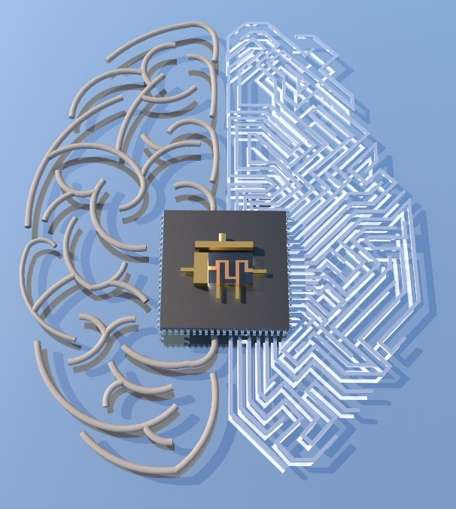
Reconfigurable 2D Materials with Neuromorphic Functionality
NSF DMR-1720139
2018
IRG-1, Northwestern University MRSEC
Solid-state electronics and advanced computation has spurred significant interest in artificial intelligence and neuromorphic (i.e., brain-like) computing. However, the deterministic correlations between input and action in conventional silicon microelectronics are not well-matched to information processing in biological systems. In particular, neuronal networks blur the lines between inputs and actions in that the extremely large number of connections (synapses) between neurons (>1000 synapses to 1 neuron) rather than the density of neurons establish the hierarchy of perception and action. By exploiting the two-dimensional (2D) geometry and rapid defect motion in monolayer polycrystalline MoS₂, the Northwestern University MRSEC has realized the first experimental demonstration of a multi-terminal hybrid memristor and transistor (i.e., memtransistor). The seamless integration of a memristor and transistor into one multi-terminal device has the potential to simplify artificial neuronal network architectures in addition to providing opportunities for studying the unique physics of defect kinetics in 2D materials.
Nature, 554, 500-504 (2018).
Reconfigurable defect structure in MoS₂ enables a new circuit element, a “memtransistor,” with high potential for neuromorphic computing.
Notes:
For more information, please see the following publication: V. K. Sangwan, H.-S. Lee, H. Bergeron, I. Balla, M. E. Beck, K.-S. Chen, and M. C. Hersam, “Multi-terminal memtransistors from polycrystalline monolayer MoS₂,” Nature, 554, 500-504 (2018). DOI: 10.1038/nature25747. https://www.nature.com/articles/nature25747

