Slide 1
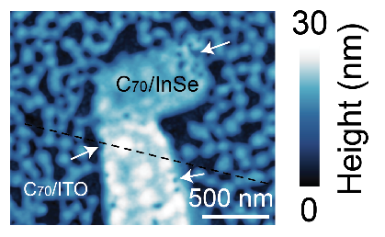
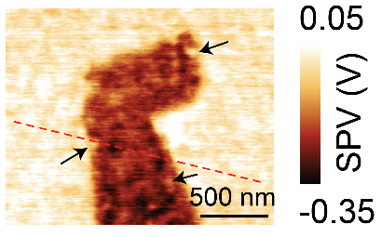
Mixed-Dimensional InSe-Organic van der Waals Heterostructures
NSF DMR-1720139
2020
IRG-1, Northwestern University MRSEC
Layered indium selenide (InSe) is an emerging two-dimensional semiconductor that has shown significant promise for high-performance transistors and photodetectors. The range of optoelectronic applications for InSe can potentially be broadened by forming mixed-dimensional van der Waals heterostructures with zero-dimensional molecular systems that are widely employed in organic electronics and photovoltaics. In a 5 PI collaboration within NU-MRSEC IRG-1, photoinduced charge separation is probed between InSe and two organic molecular semiconductors using novel experimental techniques that combine laser illumination with conductive scanning probe microscopy. In addition to providing insight for mixed-dimensional InSe-organic van der Waals heterostructures, this work establishes a general experimental methodology for studying localized charge transfer at the molecular scale that is applicable to other photoactive nanoscale systems.
ACS Nano, 14, 3509 (2020).
(a)
(b)
(c)
(a) By combining laser excitation with conductive scanning probe microscopy, photoinduced charge separation is spatially mapped between the 2D inorganic semiconductor InSe and the 0D organic molecular semiconductor C70. (b) Topography and (c) surface photovoltage map of the C70/InSe mixed-dimensional van der Waals heterojunction.
Notes:
For more information, please see the following publication (NU-MRSEC IRG-1 PIs in bold): Shaowei Li, Chengmei Zhong, Alex Henning, Vinod K. Sangwan, Qunfei Zhou, Xiaolong Liu, Matthew S. Rahn, Spencer A. Wells, Hong Youl Park, Jan Luxa, Zdeněk Sofer, Antonio Facchetti, Pierre Darancet, Tobin J. Marks, Lincoln J. Lauhon, Emily A. Weiss, and Mark C. Hersam, “Molecular-Scale Characterization of Photoinduced Charge Separation in Mixed-Dimensional InSe-Organic van der Waals Heterostructures,” ACS Nano, 14, 3509 (2020).

