Slide 1
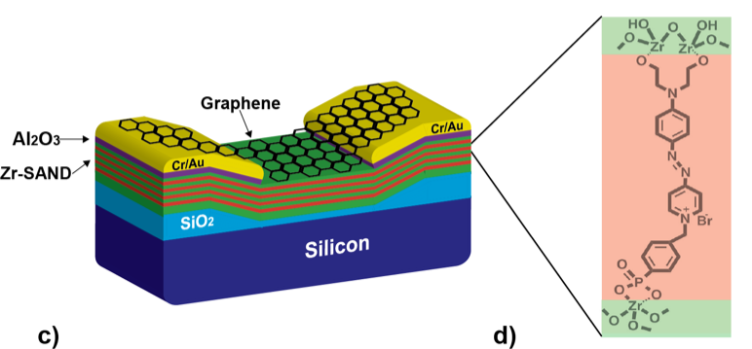
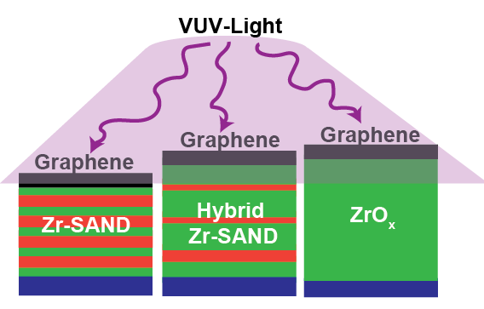
Radiation-Hard Graphene Electronic Devices via Hybrid Dielectrics
NSF-MRSEC DMR-1121262
Mark Hersam and Tobin Marks, Northwestern University MRSEC
Solution-processed semiconductor and dielectric materials are attractive for satellite technology due to their light-weight, low-voltage operation, and mechanical robustness, but their response to ionizing radiation environments is not well understood. In this study, the radiation response of graphene field-effect transistors employing hybrid organic/inorganic solution-processed zirconia self-assembled nanodielectrics (Zr-SANDs) are quantified. Competing degradation mechanisms are found in the organic versus the inorganic dielectric layers, which enables the overall radiation response to be minimized by varying the relative thickness of these constituent layers. This work thus establishes that the radiation response of graphene electronic devices can be tailored to achieve a desired radiation sensitivity by incorporating hybrid organic/inorganic gate dielectrics.
ACS Appl. Mater. Interfaces, 8, 5058 (2016).
Radiation-hard graphene transistors are enabled by integration with hybrid Zr-SAND.
Notes:
For more details, please see the following publication: H. N. Arnold, C. D. Cress, J. J. McMorrow, S. W. Schmucker, V. K. Sangwan, L. Jaber-Ansari, R. Kumar, K. P. Puntambekar, K. A. Luck, T. J. Marks, and M. C. Hersam, ACS Appl. Mater. Interfaces, 8, 5058-5064 (2016).
This project is a collaboration between Mark Hersam and Tobin Marks of Northwestern University MRSEC IRG 3 in addition to Cory Cress of the Naval Research Laboratory.

