Slide 1
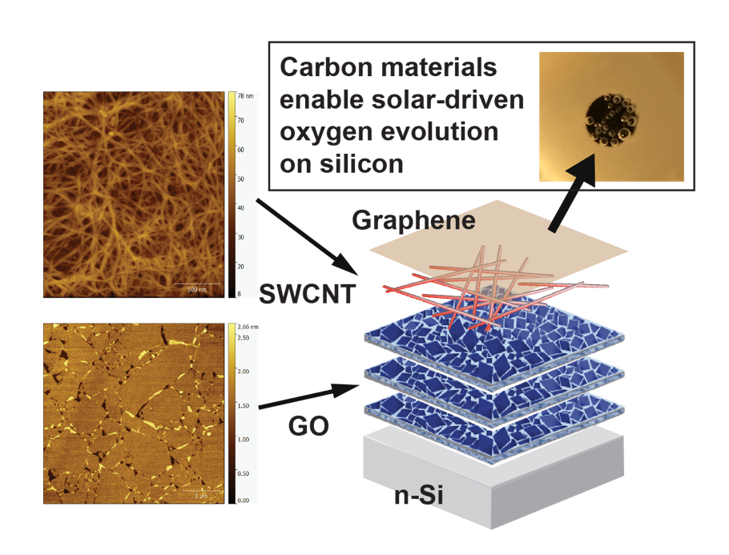
Metal-Free Carbon-Based Nanomaterial Coatings Protect Silicon Photoanodes in Solar Water-Splitting
NSF-MRSEC DMR-1121262
Mark Hersam, and Lincoln Lauhon, Northwestern University MRSEC
Solar water splitting converts solar energy into chemical fuels that can be easily stored and transported. Silicon is already used on a large scale for photovoltaics, but it is unstable in the electrolytes used for water oxidation. Here, graphene and carbon nanotubes, which are respectively single-atom-thick sheets and tubes of carbon, protect silicon anodes and enable water oxidation with increased efficiency. Holes, one type of excited charge carrier, are extracted from the silicon into the sorted semiconducting carbon nanotubes before loss can occur via recombination or corrosion. Unlike prior protective layers, these films contain no precious metals and can be deposited from solution under ambient conditions, providing a route towards large-scale, low-cost solar fuel production.
Atomic force microscope images (left), schematic (center), and photograph (top right) of a film with layers of graphene oxide, semiconducting single-walled carbon nanotubes, and graphene. This combination allows silicon to drive oxygen evolution (bubbles in photograph) by protecting the silicon and more efficiently extracting charge carriers (holes).
Nano Lett., 16, 7370 (2016)
Notes:
P-type sorted semiconducting single-walled carbon nanotubes increase the electrochemical photocurrent of silicon photoanodes tested in aqueous electrolytes from pH 0 – 14, consistent with the formation of a p-n heterostructure and inversion layer in the silicon that facilitates hole extraction. The addition of graphene improves stability and performance, and graphene oxide appears to reduce recombination at the silicon-CNT interface. The complete structure yields water-splitting photocurrents of ~8 mA/cm² under AM1.5 1-sun illumination, demonstrating that solution-processed carbon films are a viable alternative to existing silicon photoanode protection strategies that require precious metals and vapor deposition processes.

