Slide 1
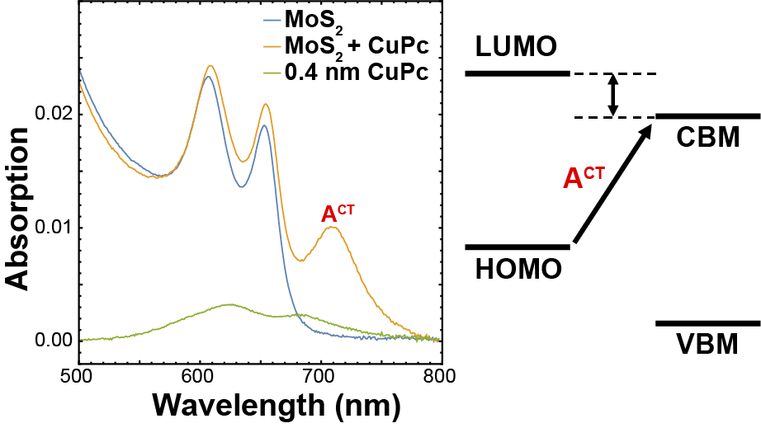
Electronic Coupling in Organic-Transition Metal Dichalcogenide Heterojunctions
NSF DMR-1720139
2018
IRG-1, Northwestern University MRSEC
Heterojunctions containing two-dimensional materials can give rise to unique effects at the interface or enhance existing optical properties of the composite layers. Using organic molecules in these heterojunctions has the advantage to enable synthetically tunable electronic and optical properties. The combination of 2D transition metal dichalcogenides with pthalocyanines (Pc), organic dye molecules consisting of an aromatic macrocycle bonded to a metal core atom has been explored. In particular, a new low-energy absorption peak in Pc-MoS₂ heterojunctions emerges due to charge transfer interactions between the adsorbed molecules and the 2D substrate, revealing the importance of band and energy level alignment on mixed-dimensional interfaces.
(top) Bilayer and monolayer MoS₂ are interfaced with metal-core phthalocyanine molecules. (bottom) A low-energy absorption peak emerges due to charge transfer across the Pc-MoS₂ heterojunction.

