Slide 1
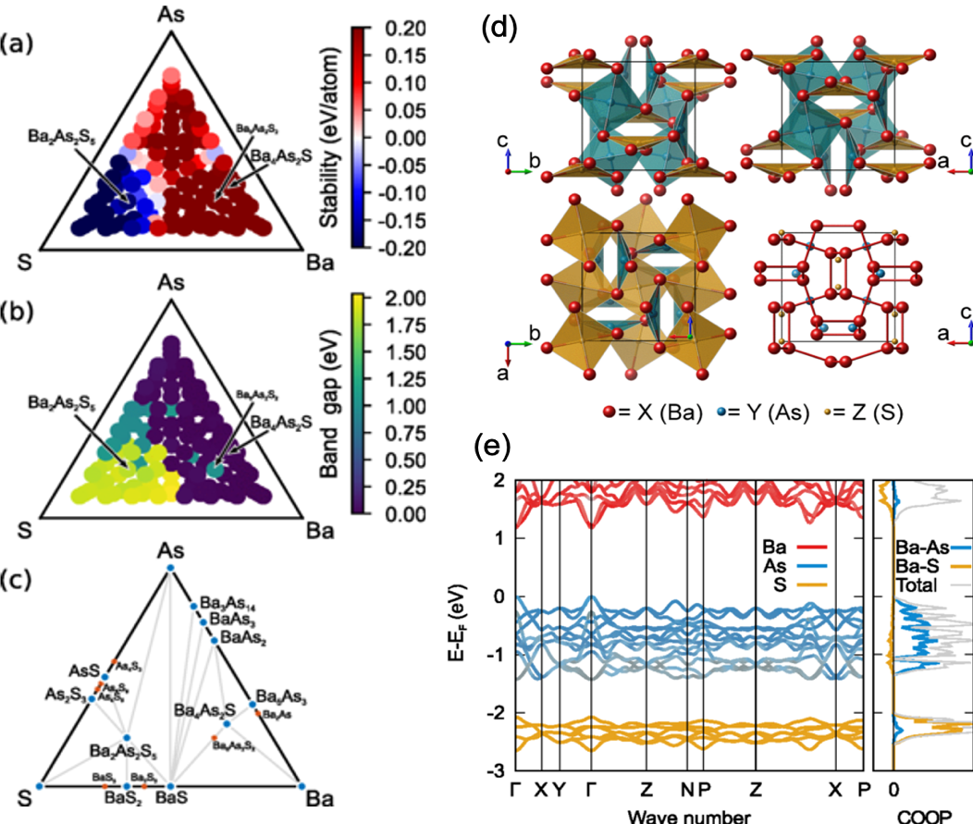
Machine-Learning Guided Discovery of Ternary Heteroanionic Semiconductors
NSF DMR-1720139
2020
IRG-2, Northwestern University MRSEC
Recently, novel methods based on materials informatics and machine-learning (ML) models have emerged to assist the search for materials with improved properties in industrially relevant applications. To apply this approach in heteroanionic materials (HetMs) discovery, NU-MRSEC IRG-2 has reported a computational investigation of a series of ternary HetMs with tunable band gaps from machine-learning and crystal structure prediction. The compositions for these materials were predicted through a search guided by machine learning, while the structures were resolved using the minima hopping crystal structure prediction. Several candidates X₄Sb₂Se (X=Mg, Ca, Sr, Ba) have been predicted to exhibit strong optical absorption in the visible range, while others show promising thermoelectric performance due to high power factors and low lattice thermal conductivities.
(a) Stability and (b) band gap energy of the Ba–As–S ternary system predicted using machine learning models. (c) Predicted convex hull construction. (d) Predicted structural details of X₄Y₂Z compounds. (e) Representative electronic structure of Ba₄As₂S.
Physical Review Materials, 3, 035404 (2019).

