Slide 1
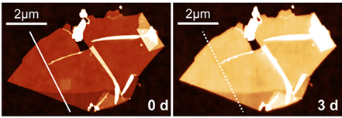
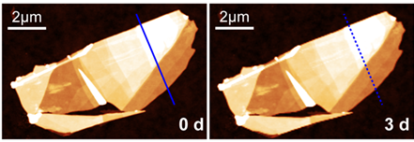
Improving the Ambient Stability of Chemically Reactive 2D Materials
NSF DMR-1720139
2019
IRG-1, Northwestern University MRSEC
The vast majority of work on two-dimensional (2D) materials has been limited to the few systems that are stable in ambient conditions. However, hundreds of additional 2D materials are highly reactive chemically and thus require passivation schemes to enable study and use in real-world settings. Among those chemically reactive 2D materials, indium selenide (InSe) is of particular interest due to its exceptional charge carrier mobility and strong optical response. To enable ambient processing and study of InSe, NU-MRSEC IRG-1 has developed a mixed-dimensional organic/inorganic passivation scheme based on n-methyl-2-pyrrilodone (NMP) seeded atomic layer deposited (ALD) alumina that provides a pinhole-free encapsulation layer that preserves the intrinsic electronic properties of the underlying InSe. Since ALD is a highly scalable process, this work will accelerate ongoing efforts to integrate InSe nanosheets into electronic and optoelectronic technologies
Nano Letters, 18, 7876-7882 (2018).
A
B
C
D
(A,B) Indium selenide (InSe) nanosheets are susceptible to deleterious oxidation, leading to increases in thickness when comparing atomic force microscopy images (A) before and (B) after 3 days of ambient exposure. (C,D) In contrast, InSe that has been passivated with a hybrid organic/inorganic encapsulation layer remains invariant (C) before and (D) after ambient exposure.
Notes:
For more information, please see the following publication: S. A. Wells, A. Henning, J. T. Gish, V. K. Sangwan, L. J. Lauhon, and M. C. Hersam, “Suppressing ambient degradation of exfoliated InSe nanosheet devices via seeded atomic layer deposition encapsulation,” Nano Letters, 18, 7876-7882 (2018).

