Slide 1
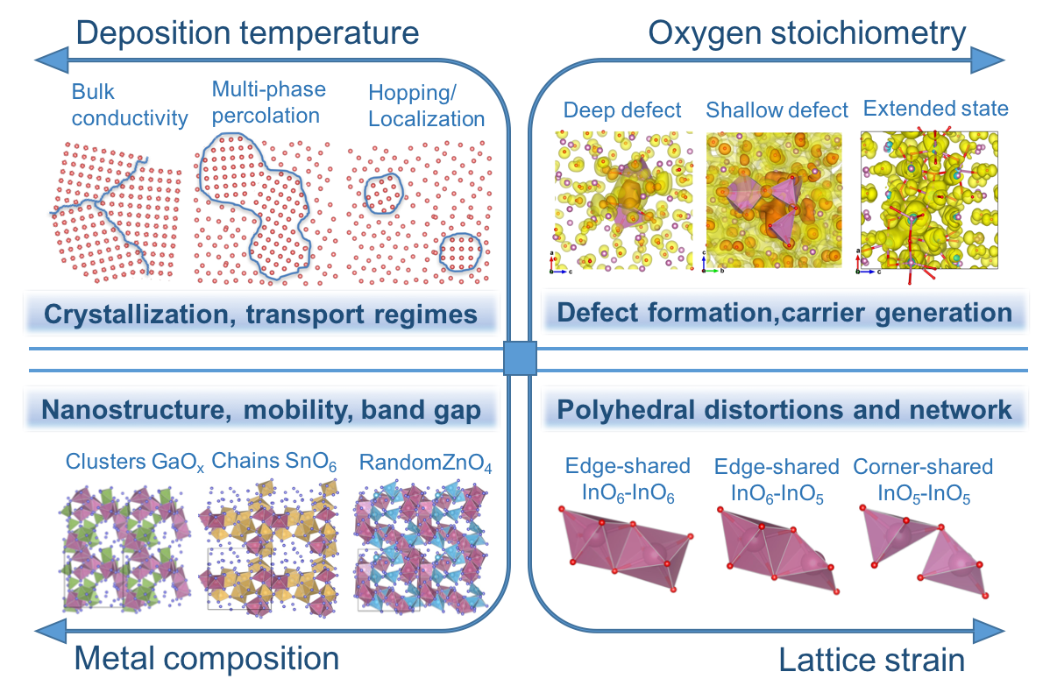
Parameter Space for Amorphous Oxide Semiconductors (AOSs)
NSF-MRSEC DMR-1121262
Julia Medvedeva and Robert Chang, Northwestern University MRSEC
The combined results of controlled synthesis, ab-initio molecular-dynamics liquid-quench simulations, thorough structure and property characterization, and accurate density-functional calculations helped identify four major components that govern the electrical, optical, thermal, and mechanical properties of prototype In-based AOSs: (i) deposition temperature; (ii) oxygen stoichiometry; (iii) cation composition; and (iv) lattice strain, Figure.
Microscopic understanding gained within the unified framework, serves as a solid foundation for optimizing the properties of known AOSs and for further development and exploration of complex ternary and quaternary AOSs.
Advanced Electronic Materials (2017).
Four-dimensional parameter space of In-based AOSs derived based on integrated experimental and theoretical studies: (1) deposition temperature (or quench rates); (2) oxygen stoichiometry; (3) metal composition; and (4) lattice strain.
Notes:
The combined results of controlled synthesis, ab-initio molecular-dynamics liquid-quench simulations, thorough structure and property characterization, and accurate density-functional calculations helped identify four major components that govern the electrical, optical, thermal, and mechanical properties of prototype In-based AOSs: (i) deposition temperature; (ii) oxygen stoichiometry; (iii) cation composition; and (iv) lattice strain, Figure.
Microscopic understanding gained within the unified framework, serves as a solid foundation for optimizing the properties of known AOSs and for further development and exploration of complex ternary and quaternary AOSs.

