Slide 1
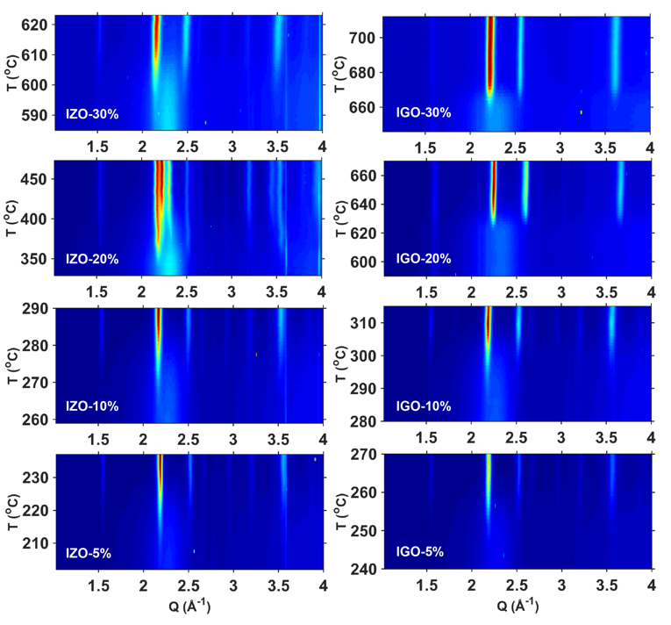
Amorphous to Crystalline Transition in Indium Oxide Semiconductors
NSF-MRSEC DMR-1121262
IRG-2, Northwestern University MRSEC
Amorphous oxide semiconductors commonly are indium oxides doped with other metal ions. Although it is known that the introduction of secondary metal ions decreases the degree of crystallinity and elevates the crystallization temperature, there is a lack of systematic study to compare and quantify the effects of different dopant elements. In an interdisciplinary study within IRG-2 of the Northwestern University MRSEC, in situ synchrotron X-ray characterization was performed to characterize the isochronal crystallization process of oxide thin films synthesized by pulsed laser deposition. This systematic study indicated that introducing secondary metal ions elevates the crystallization temperature, with zinc and gallium dopants being found to be especially effective in maintaining the amorphous state. This work will inform ongoing efforts to improve the properties of amorphous oxide semiconductors in electronic applications.
Synchrotron X-ray diffraction allows the evolution of the atomic structure of oxide films to be measured during crystallization.

