Slide 1
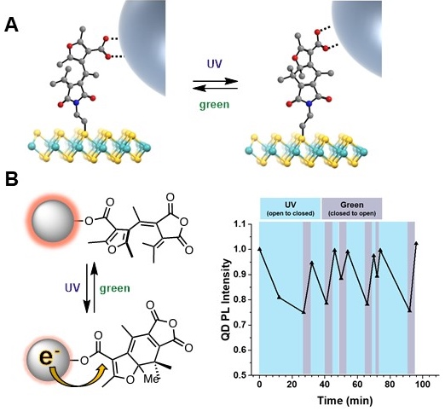
Ultrafast Photoswitches for Reconfigurable Mixed-Dimensional Heterojunctions
NSF DMR-1720139
2020
Seed Research, Northwestern University MRSEC
Two-dimensional semiconducting materials such as MoS₂ can be photosensitized with a zero-dimensional system such as CdSe quantum dots (QDs) to enhance optoelectronic properties. Upon photoexcitation of the QDs, charge transfer occurs across the mixed-dimensional heterojunction interface to the underlying MoS₂ in less than one picosecond. This Northwestern University MRSEC seed project is designing and building molecules to bridge the QD-MoS₂ interface, thus enabling control over this ultrafast charge transfer. These photoswitchable molecules can be rapidly toggled between two different states using different colors of light. Since this toggling also occurs on the picosecond time scale, it can dynamically reconfigure the charge transfer process, leading to quenched QD photoluminescence. These results provide a novel pathway to ultrafast control of mixed-dimensional heterojunction charge transfer.
(A) Design of a photoswitchable bridging molecule that controls charge transfer from CdSe quantum dots to MoS₂. (B) CdSe photoluminescence is reversibly controlled by electron transfer to the photoswitch.

