Slide 1
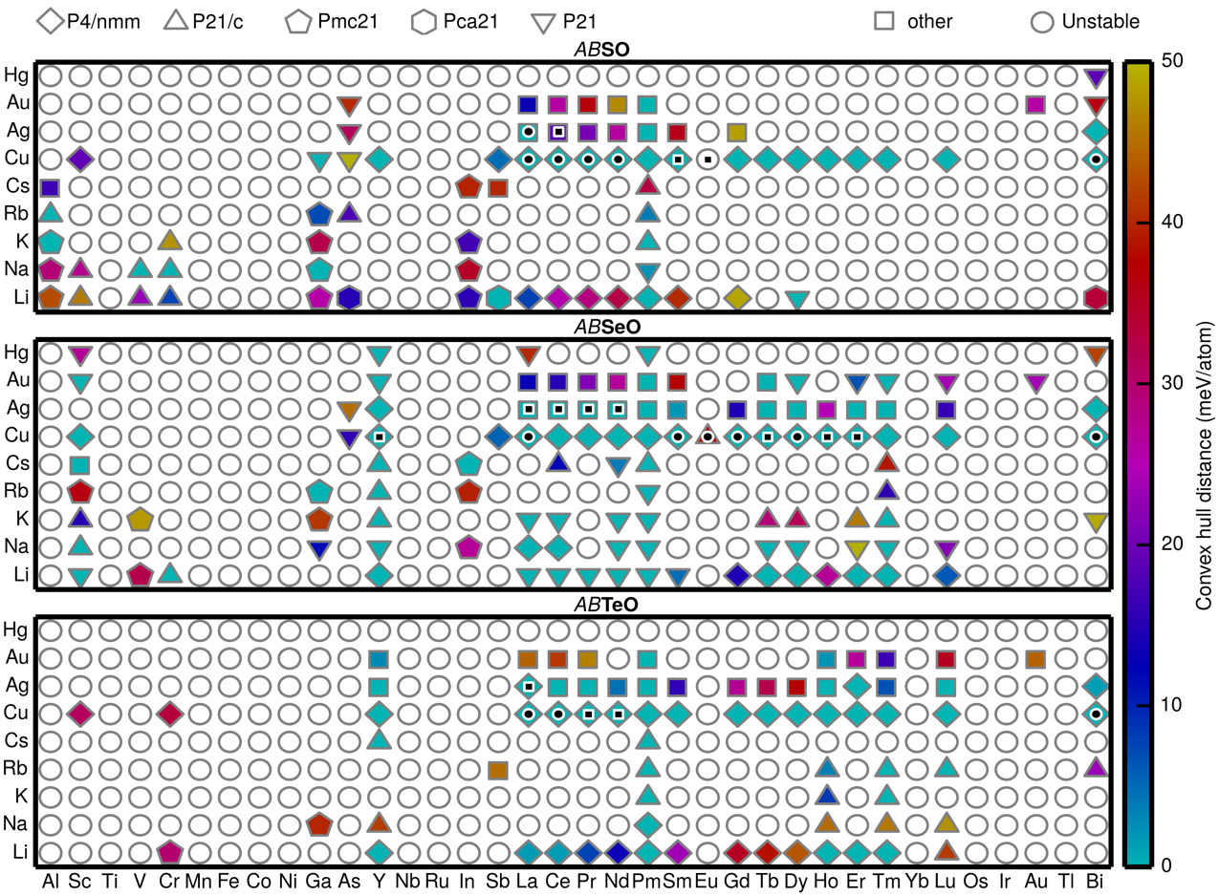
Computational Discovery of New Oxychalcogenide Compounds
NSF DMR-1720139
2018
IRG-2, Northwestern University MRSEC
High-throughput density functional theory (DFT) calculations are used to accelerate the discovery of new oxychalcogenide compounds. In particular, experimentally-known crystal structures are decorated with essentially all possible combinations of elements in the periodic table, generating thousands of potential compounds. High-throughput DFT calculations carried out on these compounds are then screened for thermodynamic stability utilizing the Open Quantum Materials Database. Several of the newly predicted oxychalcogenide compounds are predicted to have promising applications such as thermoelectrics, transparent conductors, photovoltaics, and lithium superionic conductors.
Heat map of the convex hull distance of A⁺B³⁺OX (X=S, Se, and Te) compounds. Diamond, triangle, pentagon, hexagon, inverted triangle, and square represent P4/nmm, P21/c, Pmc21, Pca21, P21, and other space groups, respectively. The white circle means the compound is unstable.

