Slide 1
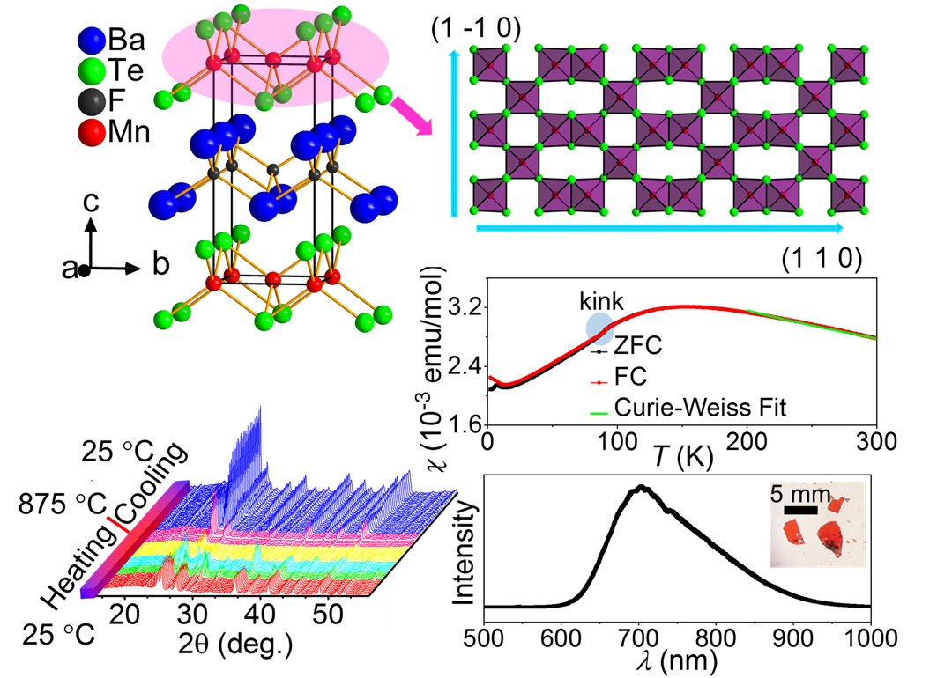
Photoluminescence and Antiferromagnetism in the New Heteroanionic Material BaFMn_{0.5}Te
NSF DMR-1720139
2019
IRG-2, Northwestern University MRSEC
Semiconductors with both magnetic and optoelectronic properties are relevant for novel spintronic devices. With the aim of discovering new magnetic semiconductors, NU-MRSEC IRG-2 performed synthesis investigations on mixed halide-chalcogenides, resulting in the discovery of the new compound BaFMn_{0.5}Te. This heteroanionic material contains magnetic ions in a layered heterostructure with alternating positive [BaF]⁺ and negative [Mn_{0.5}Te]⁻ layers. An in situ powder X-ray diffraction study of the synthesis path was conducted to determine the formation mechanism of BaFMn_{0.5}Te. BaFMn_{0.5}Te has strong red photoluminescence (~700 nm) and concurrent antiferromagnetism below 90 K. Theoretical analysis indicates that both of these properties derive from the unique Mn atom ordering pattern and the mixed F/Te anion nature of the system. This work provides confirmation that heteroanionic materials can exhibit unexpected and rare combinations of properties.
BaFMn_{0.5}Te has a unique [Mn_{0.5}Te]⁻ layer with corner and edge sharing MnTe₄ tetrahedra. The formation of BaFMn_{0.5}Te was explored by in-situ X-ray diffraction. This compound has strong red photoluminescence with concurrent antiferromagnetism emerging below 90 K.

