Slide 1
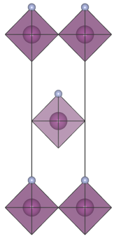
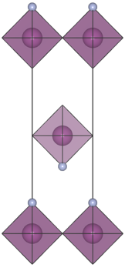
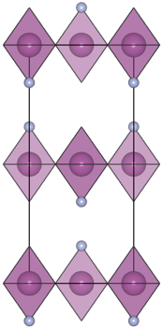
Polyhedral Assembly of Heteroanionic Materials
NSF DMR-1720139
2018
IRG-2, Northwestern University MRSEC
A route has been formulated that leverages heteroleptic building units to lift inversion symmetry in heteroanionic materials from balancing short-range and long-range interactions favoring octahedral tilting in perovskite-derived structures. The resulting increase in the number of noncentrosymmetric (NCS) materials is important for improving the performance of compounds found in actuator, imaging, and data storage technologies. NCS materials are challenging to discover in homoanionic materials, because the building units often assemble to maintain inversion. In contrast, heteroanionic materials constructed from heteroleptic units (metals bonded to more than one ligand), enable a greater landscape from which to design NCS materials. The design strategy developed here expands the number of NCS compounds suitable for device platforms relying on broken inversion.
Anion orders compatible with the parent Ruddlesden-Popper structure. From left to right: polar, antipolar layers, and antipolar-in-layer anion order. The gray anions at the octahedral vertices indicate the position of the fluoride ion.

