Slide 1
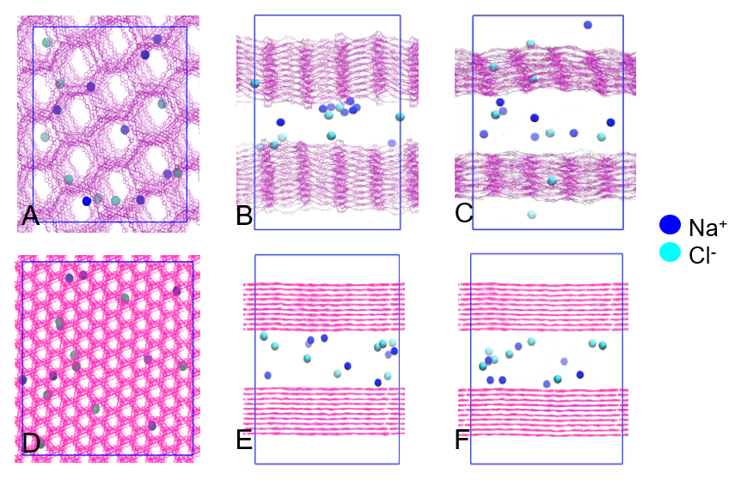
Improving Water Desalination with Molecularly Precise Porous Membranes
NSF DMR-1720139
2020
Super-Seed, Northwestern University MRSEC
Water desalination offers a promising solution to the shortage of fresh water, which is among the most critical issues facing modern society. With molecularly precise porosity, covalent organic frameworks (COFs) are ideal candidate membranes for this purpose. Through molecular dynamics simulations, the Northwestern University MRSEC Super-Seed has studied the dependence of pore size dimension on the desalination properties of COF membranes. In particular, for pore sizes between 1 nm and 2.8 nm, COF membranes prevent the flow of sodium chloride ions while allowing for efficient transport of water molecules. This study thus identifies the optimal pore size range for desalination, which will inform the design of COF-based water purification membranes.
(A-C) Covalent organic frameworks (COFs) with pore sizes larger than 2.8 nm allow free passage of sodium chloride ions: (A) Top view, (B) Side view initially, (C) Side view after 50 ns. (D-F) In contrast, COFs with pore sizes between 1 nm and 2.8 nm block sodium chloride ions, enabling efficient desalination: (D) Top view, (E) Side view initially, (F) Side view after 50 ns.

