Slide 1
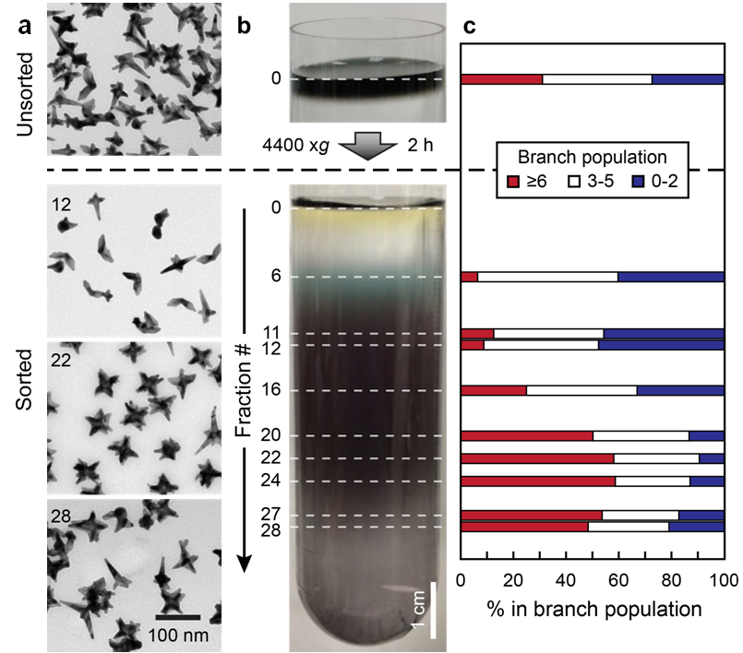
Homogeneous Gold Nanostars
NSF-MRSEC DMR-1121262
Mark Hersam and Teri Odom, Northwestern University MRSEC
Anisotropic gold nanoparticles have been shown to possess desirable plasmonic and optical properties at the single particle level, but ensemble averaged measurements are compromised by the as-synthesized polydispersity in nanoparticle size and shape. To address this issue, density gradient centrifugation has been used to separate and remove spherical gold nanoparticles from gold nanostar samples in addition to enriching gold nanostars by the number of branches. In particular, sucrose gradients have been employed due to their compatibility with a wide range of functionalization chemistries for gold nanoparticles. In addition to plasmonic applications, these homogeneous gold nanostar samples show promising as contrast agents for magnetic resonance imaging.
J. Phys. Chem. C, 120, 22103 (2016).
Density gradient centrifugation refines the shape distribution of gold nanostars in aqueous solution.
Notes:
For more details, please see the following publication: K. S. B. Culver, Y. J. Shin, M. W. Rotz, T. J. Meade, M. C. Hersam, and T. W. Odom, J. Phys. Chem. C, 120, 22103 (2016).
This project is a collaboration between Mark Hersam and Teri Odom of Northwestern University MRSEC IRG 3.

