Slide 1
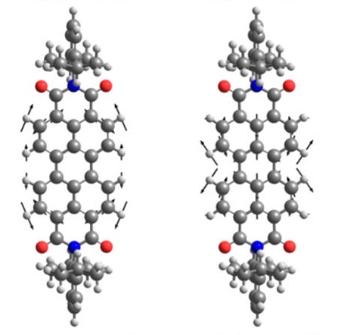
Probing Intermolecular Interactions with Intramolecular Resolution
NSF-MRSEC DMR-1121262
IRG-3, Northwestern University MRSEC
At the nanometer-scale, the surface area to volume ratio increases substantially compared to bulk materials. Consequently, methods for functionalizing and passivating surfaces can play a dominant role in determining the properties of nanomaterials. Of particular interest are self-assembled monolayers of organic molecules that have been widely used to control the electronic, optical, chemical, and frictional properties of nanomaterials in a range of applications. To elucidate the fundamental chemical interactions in self-assembled monolayers, correlated ultrahigh vacuum tip-enhanced Raman spectroscopy and time-dependent density functional theory have been employed. This novel methodology provides direct insight into the strength of intermolecular interactions in self-assembled monolayers, ultimately probing surface-bound organic molecules with unprecedented intramolecular resolution.
J. Am. Chem. Soc. 139, 18664 (2017).
Schematic of the molecular structure and vibrational modes of the perylene diimide molecules used in this study.
Notes:
For more details, please see the following publication: N. Chiang, N. Jiang, L. R. Madison, E. A. Pozzi, M. R. Wasielewski, M. A. Ratner, M. C. Hersam, T. Seideman, G. C. Schatz, and R. P. Van Duyne, “Probing intermolecular vibrational symmetry breaking in self-assembled monolayers with ultrahigh vacuum tip-enhanced Raman spectroscopy,” J. Am. Chem. Soc., 139, 18664-18669 (2017).
This project is a multi-PI collaboration involving Tamar Seideman, George Schatz, Mark Hersam, and Richard Van Duyne of Northwestern University MRSEC IRG 3.

