Slide 1
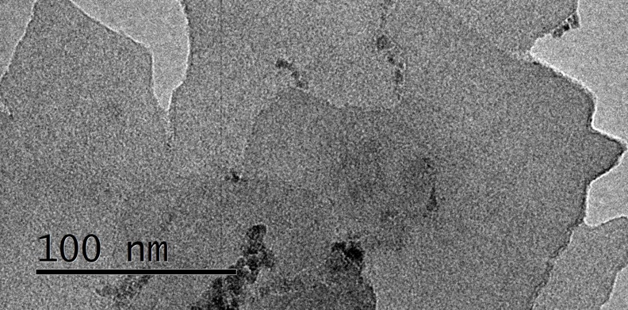
Processing 2D Porous Polymers into Membranes via Exfoliation
NSF DMR-1720139
2019
Super-Seed, Northwestern University MRSEC
Two-dimensional covalent organic frameworks (2D COFs) are ordered, permanently porous polymers with intuitive designed structures. These molecularly precise porous materials are of high interest for separation membranes, organic electronic devices, catalyst supports, and related applications. However, 2D COFs are typically isolated as polycrystalline, insoluble powders that are not easily processed into forms that enable these potential applications. The NU-MRSEC Super-Seed team has developed a method to process imine-linked 2D COF powders into thin films via reversible exfoliation. The COF powder is treated with strong acids, which causes each layer to become positively charged. This charged form is exfoliated in solvents with gentle sonication, which provides a suspension of nanosheets. The suspension is cast on substrates and treated with base to obtain an insoluble thin film that retains the original 2D COF chemical structure and porosity. This processing advance enables 2D COF membranes on polymer supports that are promising for water filtration applications.
A
B
(A) Schematic of a highly charged COF prior to exfoliation. (B) TEM of exfoliated 2D COF nanosheets.

