Slide 1
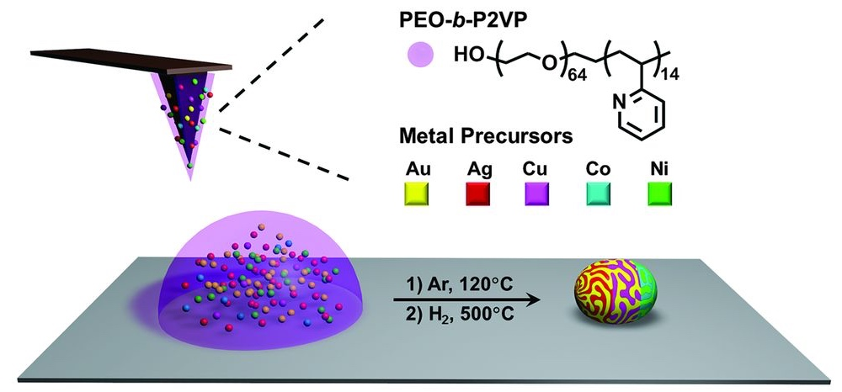
Polyelemental Nanoparticle Libraries
NSF-MRSEC DMR-1121262
M. Hersam, V. Dravid, C. Mirkin, Northwestern University MRSEC
Multimetallic nanoparticles are useful in many fields (such as catalysis, electronics, optics, and magnetism), yet there are no effective strategies for synthesizing libraries of such structures with systematic compositional tunability. Mirkin used scanning probe block copolymer lithography (SBPCL, a technique invented in the Mirkin group) to synthesize multimetallic nanoparticles with independently controllable size and composition, incorporating up to five metals. SBPCL relies on the deposition of a polymer nanoreactor loaded with metal ion precursors, which are subsequently aggregated and reduced into multimetallic nanoparticles. This project leveraged collaborations with Hersam (IRG 3) and Dravid (IRG 2).
Synthesis of multimetallic nanoparticles via scanning probe block copolymer lithography, based upon the aggregation and reduction of multiple metal ion precursors in a polymer nanoreactor
Science, 352, 1565 (2016)
Notes:
Multimetallic nanoparticles are useful in many fields (such as catalysis, electronics, optics, and magnetism), yet there are no effective strategies for synthesizing libraries of such structures with systematic compositional tunability. Mirkin used scanning probe block copolymer lithography (SBPCL, a technique invented in the Mirkin group) to synthesize multimetallic nanoparticles with independently controllable size and composition, incorporating up to five metals. SBPCL relies on the deposition of a polymer nanoreactor loaded with metal ion precursors, which are subsequently aggregated and reduced into multimetallic nanoparticles. This project leveraged collaborations with Hersam (IRG 3) and Dravid (IRG 2).

