Slide 1
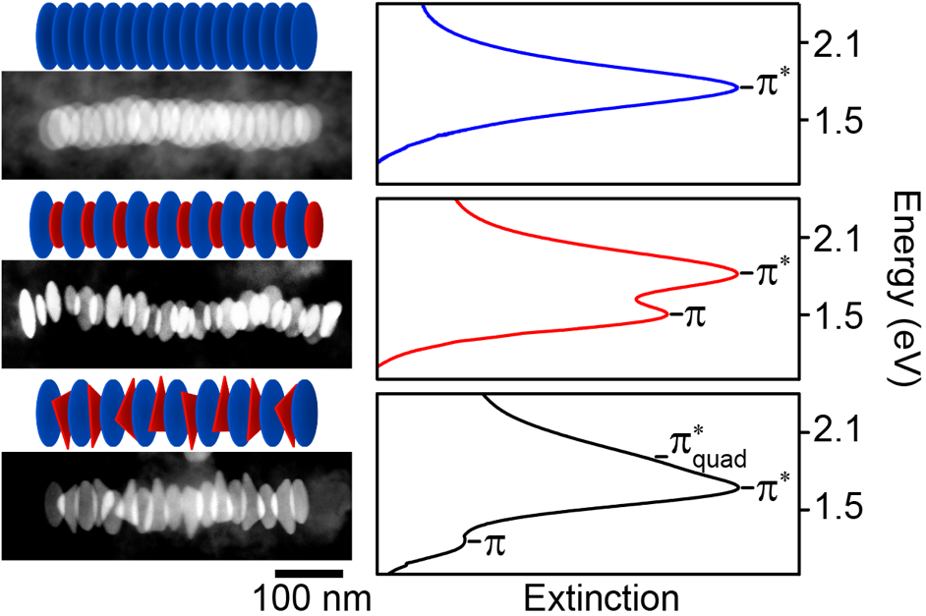
Tuning Optical Properties with DNA-Linked Gold Nanodisk Stacks
NSF-MRSEC DMR-1121262
IRG-3, Northwestern University MRSEC
Recent advances in gold nanoparticle synthesis combined with functionalization with DNA linkers has enabled the self-assembly of stacks of gold nanodisks in which the optical spectra can be tuned and modulated by controlling the stack structure (e.g., particle spacing, arrangement, and stack length). The figure shows three possible arrangements of the particles, and the corresponding spectra that are associated with the plasmon resonance excitation in the stack. Theoretical models of both the stack structure and optical spectra provide a quantitative description of the results, including an understanding of the spectra in terms of plasmon hybridization. This work will inform ongoing efforts to realize a wide range of plasmonic applications.
Nano Letters, 17, 5830 (2017).
(Left) Scanning electron microscopy images of DNA-linked gold nanodisk stacks. (Right) Optical extinction spectra of the stacks.

