Slide 1
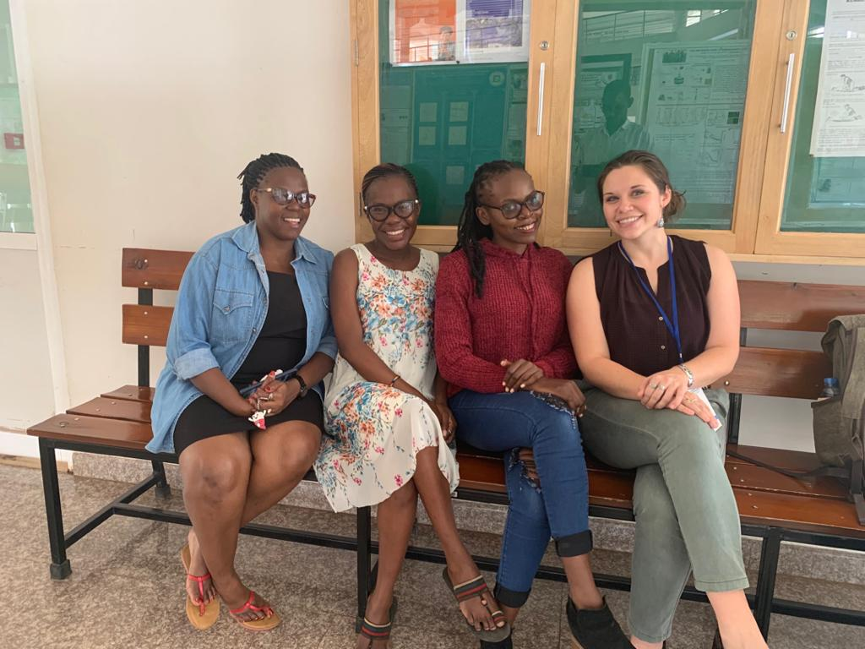
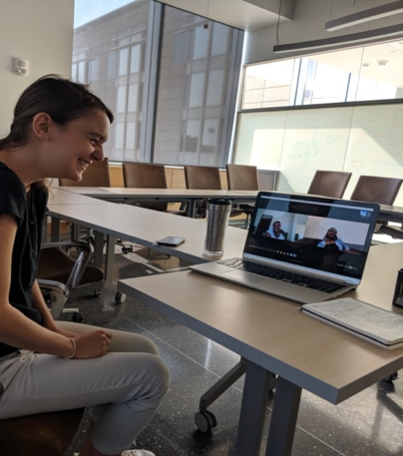
Professional Development Workshops: Supporting Women in STEM in Tanzania
NSF DMR-1720139
2020
Education/Outreach, Northwestern University MRSEC
The Northwestern University MRSEC sponsors the Women Supporting Women in the Sciences initiative, which is a partnership with the University of Dodoma and the Nelson Mandela African Institution for Science and Technology in Tanzania. This initiative develops professional development workshops for female STEM students. Jointly, Northwestern participants and Tanzanian volunteers have designed and implemented online and on-site workshops with local facilitators at Tanzanian sites. Throughout the content development phase, feedback was received from additional partners in Tanzania and from the Center for the Integration of Research, Teaching, and Learning at Northwestern in an effort to maintain culture relevance. The program outcomes were highlighted in an American Physical Society press release.
The Women Supporting Women in the Sciences initiative develops professional development workshops for women in STEM in Tanzania. The program outcomes were highlighted in an American Physical Society press release.

