Slide 1
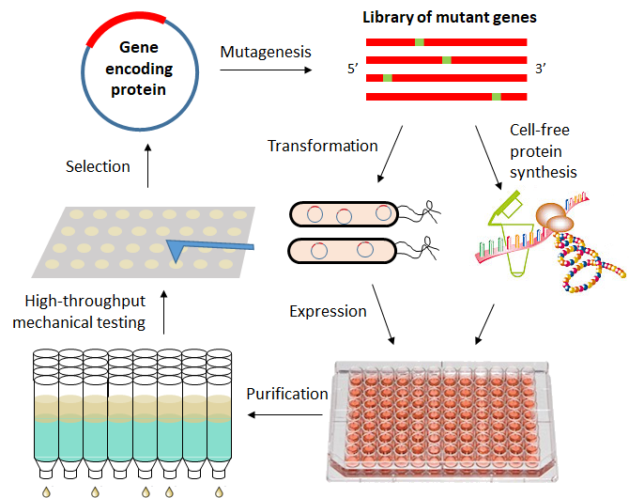
Discovering and Designing New Materials Using Directed Evolution
NSF DMR-1720139
2018
Seed Research, Northwestern University MRSEC
In a new seed project within the Northwestern University MRSEC, a novel approach for discovering and designing materials is being developed using directed evolution. While directed evolution approaches have been successfully applied in areas such as therapeutics or catalysis, this strategy has not been fully explored in materials science and engineering. In particular, through genetic mutation, protein expression, and high throughput materials screening, this work is applying evolutionary principles to materials design, with the initial application of engineering wet adhesion of mussel foot proteins in extreme environments. Following this proof-of-concept demonstration, this materials design approach will be generalized to other biomaterial and polymeric systems.
A schematic of the directed evolution pathway that holds promise for accelerating the discovery and design of new materials.

