Slide 1
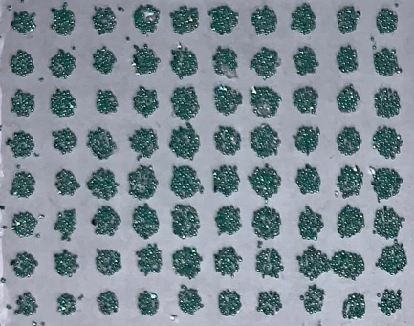
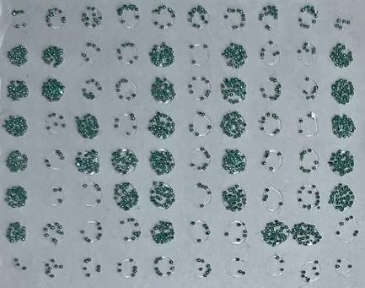
Designing Biomaterials Using High-Throughput Directed Evolution
NSF DMR-1720139
2019
Seed Research, Northwestern University MRSEC
Traditional design approaches are insufficient for exploring the vast phase space available to protein-based biomaterials. This NU-MRSEC seed-funded project is developing a platform for biomaterials design using directed evolution, which combines genetic mutation and protein synthesis with high-throughput materials characterization. This approach is being applied to the development of mussel foot proteins with favorable underwater adhesion properties in extreme environments such as unnatural pH. Advances in protein synthesis have expressed fusions of wild-type mussel foot proteins at levels sufficiently high for mechanical characterization. Specifically, a high-throughput centrifugal method for measuring adhesion energies of protein mutants has been developed and tested.
Top view
Centrifugation
5 mm
Microparticles are attached to adhesive spots on a substrate, and centrifuged to apply a known retraction force that overcomes the work of adhesion. This procedure enables high-throughput measurement of thousands of adhesive formulations in parallel.

