Slide 1
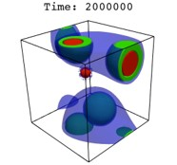
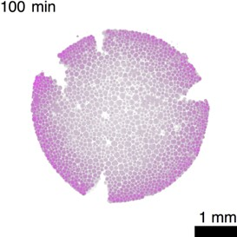
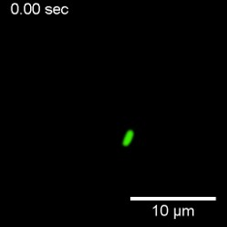
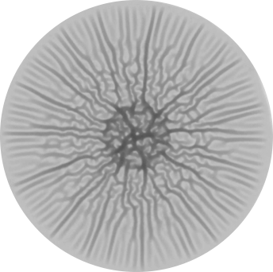
Materials Research Science and
Engineering Centers
iSuperSeed: Harnessing the Rules of Life to Enable Bio-Inspired Soft Materials
Participants (3 departments): H Stone, (MAE), S. Datta (CBE), A. Košmrlj (MAE),
B. Bassler (MOL BIO), C. Brangwynne (CBE); multiple collaborative papers to date
Goal: Focusing on two scales of biological organization - the intra- and extra-cellular levels - how do polymers drive biological function?
Innovations in visualization, quantitative experiments and simulations/theory.
Intracellular phases and evolution
Macromolecular assemblies and bacterial transport
Biofilms: mechanics, wrinkling, transport
Polymeric phases central to observed responses at different length scales.
Princeton Center for Complex Materials
MRSEC DMR-1420541
Notes:
The I-SuperSeed served to build its local community focusing on the topics of polymeric materials driving structure and function at (i) the intracellular length scale, where recent observations of phase-separated liquid phases (LEFT) are relevant to understanding responses inside cells, and (ii) extra-cellular length scales where porous material change shape or regulate run-and-tumble dynamics of swimming bacteria (middle) or evolving shapes of biofilms (right).

