Slide 1
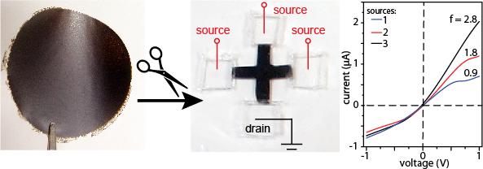
Kirigami Nanofluidics
NSF-MRSEC DMR-1121262
J. Huang, E. Luijten, M. Olvera de la Cruz, Northwestern University MRSEC
Restacked films of exfoliated 2D nanosheets can function as massive nanofluidic channel arrays. In the previous reporting year, experiments by Huang and simulations by Luijten showed that cutting such membranes into asymmetric shapes leads to ionic current rectification (ICR).
New work by Huang, Luijten, and Olvera de la Cruz clarifies the mechanism and shows new device designs. An analytical expression for the current-voltage characteristics of the system was derived, and the molecular dynamics simulation reported previously has been refined, leading to detailed quantitative agreement between theory, simulation, and experiment.
We find the ICR is caused by concentration polarization (CP) over the asymmetric interfaces. The massively parallel device geometry allows CP to impact the system resistance at very low applied voltage. We leverage this mechanism to design nanofluidic diodes, variable rectifiers, and logic gates.
Theory and MD work show that ICR is caused by CP at the asymmetric membrane-reservoir interfaces
The new mechanistic understanding enables new device designs. Here, GO membrane cut into a cross shape shows tunable ICR ratio
Gao et al, under review.
Notes:
Restacked films of exfoliated 2D nanosheets can function as massive nanofluidic channel arrays. In the previous reporting year, experiments by Huang and simulations by Luijten showed that cutting such membranes into asymmetric shapes leads to ionic current rectification (ICR).
New work by Huang, Luijten, and Olvera de la Cruz clarifies the mechanism and shows new device designs. An analytical expression for the current-voltage characteristics of the system was derived, and the molecular dynamics simulation reported previously has been refined, leading to detailed quantitative agreement between theory, simulation, and experiment.
We find the ICR is caused by concentration polarization (CP) over the asymmetric interfaces. The massively parallel device geometry allows CP to impact the system resistance at very low applied voltage. We leverage this mechanism to design nanofluidic diodes, variable rectifiers, and logic gates.

