Slide 1
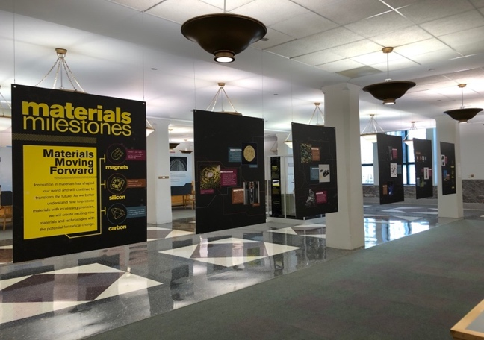
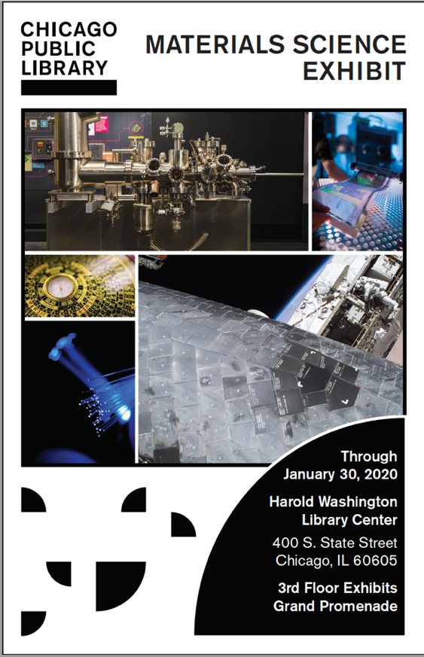
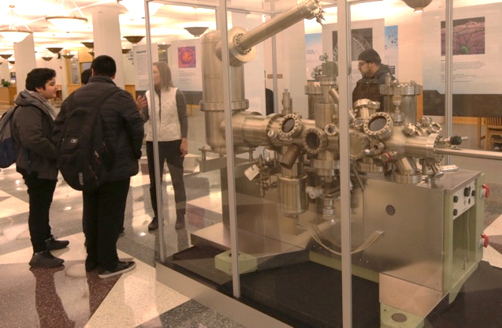
Materials Science Exhibit at the Chicago Public Library
NSF DMR-1720139
2019
Education/Outreach, Northwestern University MRSEC
In collaboration with the Chicago Museum of Science and Industry and the Chicago Public Library, the NU-MRSEC launched the Materials Science Exhibit at the Harold Washington Library in downtown Chicago. The newly updated exhibit opened to the general public on February 1, 2019 and is located in the Grand Promenade on the 3rd Floor. The exhibit includes the Microscopy Gallery, which features artistic scientific images based on the latest research of nanoscale systems studied in NU-MRSEC Shared Facilities. In 2018, over 1.36 million patrons visited the Harold Washington Library, which is the central library for the Chicago Public Library System and the primary resource for the socioeconomically diverse Chicago Public Schools.
The updated Materials Science Exhibit is currently housed at the Harold Washington Library in downtown Chicago, which is the primary resource for the socioeconomically diverse Chicago Public Schools.

