Slide 1
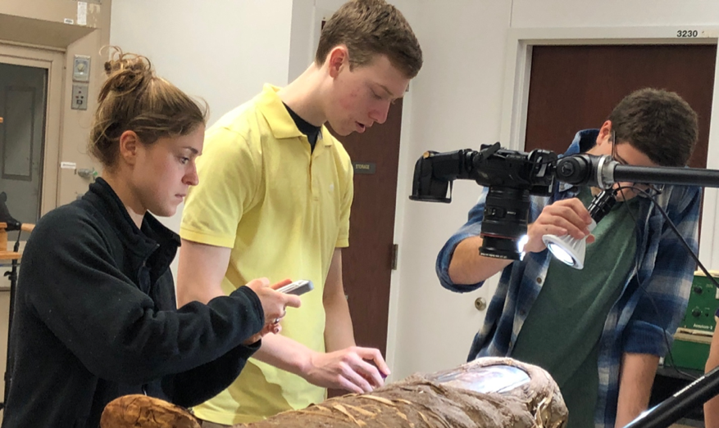
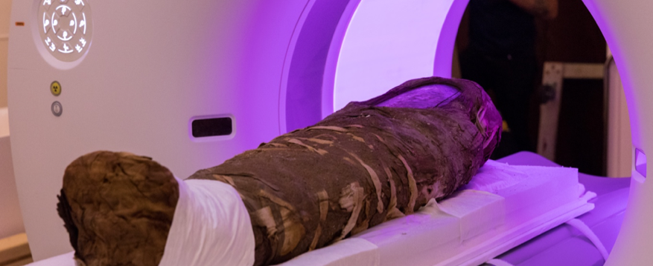
Interrogating Anthropological Mummy Relics with the Tools of Materials Science
NSF DMR-1720139
2018
Education/Outreach, Northwestern University MRSEC
The Northwestern University MRSEC supported the new exhibition Paint the Eyes Softer: Mummy Portraits from Roman Egypt at the Northwestern University Block Museum. The exhibit explores the art and science of mummy relics from the Fayum region in Egypt during the Roman period. In a unique interdisciplinary collaboration, the exhibition featured results from an advanced undergraduate seminar, which was co-listed in both the Department of Materials Science and Engineering and the Department of Classics. In this course, students collaborated with scientists and curators to conduct historical and scientific research. The exhibit also includes an augmented reality experience based on results from the scientific examination of the Hibbard Mummy at the Argonne National Laboratory Advanced Photon Source. The exhibit has been attended by more than 15,000 visitors including school groups from the socioeconomically diverse Chicago Public Schools.
Top: Undergraduate students examine the Hibbard Mummy. Bottom: The Hibbard Mummy is analyzed using Advanced Photon Source synchrotron radiation.

