Slide 1
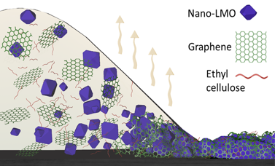
Facilitating Technology Transfer and Commercialization
NSF DMR-1720139
2020
Tech Transfer, Northwestern University MRSEC
In partnership with the Northwestern University Kellogg School of Management, McCormick School of Engineering, Pritzker School of Law, and Innovation and New Ventures Office, the Northwestern University MRSEC fosters a comprehensive innovation ecosystem that allows fundamental research to be transferred to the market via startup companies. Volexion is the most recent example, whose technology was borne out of IRG-1 of the Northwestern University MRSEC. In particular, Kellogg School of Management and McCormick School of Engineering students performed a market analysis and developed a business plan for a mixed-dimensional heterostructure technology based on lithium manganate nanoparticles and graphene. The students concluded that this material system would have the largest market potential as a high-performance cathode for lithium-ion batteries. With this business plan in hand, NU-MRSEC postdoc Ted Seo successfully competed in the Argonne Chain Reaction Innovations Program, where Volexion was selected following a national competition. Volexion is now working with major customers including XALT Energy, Tesla, and Exelon to bring high-performance lithium-ion batteries to the electric vehicle and renewable energy markets.
Mixed-D Heterostructure
Volexion is the most recent startup company to have progressed through the innovation ecosystem fostered by the Northwestern University MRSEC.

