Slide 1
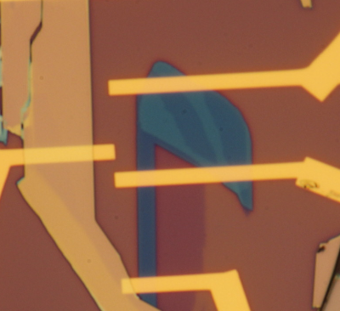
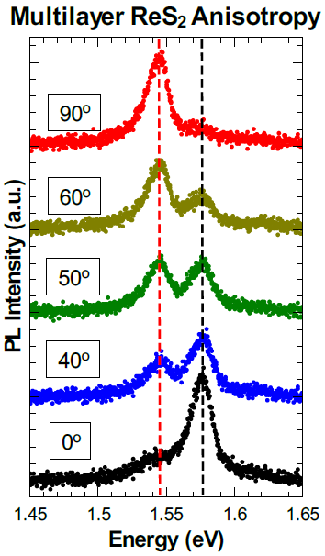
Anisotropic Polarized Emission from ReS₂
NSF-MRSEC DMR-1121262
Nathaniel P. Stern, Northwestern University MRSEC
Optical properties of layered materials can be controlled manipulating the discrete number of atomically-thin two-dimensional crystal layers. Unique amongst the layered transition metal dichalcogenides, ReS₂ has optical emission that is linearly polarized and proportional to layer number. By reducing the temperature to 10 K, we show that this emission is distinctly polarized between two well-resolved excitonic emission peaks. The 90º anisotropy is highly layer dependent for 1 - 3 layers, indicating its origin to be from interlayer exciton coupling. The distinct spectral separation and anisotropy that emerge only at low temperature provides insight into the formation, evolution, and symmetry of low-energy exciton states in layered two-dimensional semiconductors.
a.
10 µm
b.
Bulk
6-7L
2L
(a) Gated ReS₂ multilayer devices assembled from mechanical exfoliation and electron beam lithography of gold contacts.
(b) Selection of distinct exicton states in ReS₂ emission using the linear polarization angle.
Notes:
Additional Details on this experiment:
ReS₂ has sparked interest because it is a layered transition metal dichalcogenide with emission strength that apparently scales with layer number. Thus, it is hypothesized that the layers are weakly interacting, which provides possibilities for increased opto-electronic performance in layered devices. Early work on ReS₂ has been limited to room to moderate temperatures (110K) where the emission profile is an overlap of two broad peaks. These peaks have a distinct linearly polarized emission that is not aligned with the crystal axis.
In taking a few-layer and bulk sample to low temperatures (10K) we cleanly resolved the two exciton peaks and show a clear linear polarization-dependent behavior with little ambiguity due to peak smearing. By changing layer number, the anisotropy of ReS₂ changes, with the most notable effects occurring from 1 - 3 layers where there is an expected evolution of relative phase from ~40º to ~90º between the two exciton peaks. This behavior highlights an unexplained layer-number dependence in the anisotropy of the ReS₂, and indicates that the material does not behave optically as separate layers. We also observe the breakdown of this layer dependence at bulk thicknesses. In few layer unpolarized photoluminescence, the relative peak intensities of the two excitons are roughly comparable and scale linearly with increase in layer number but in the bulk case (15+ layers), there is a pronounced increase in the relative intensity of the higher energy peak (~1.58 eV) to that of the lower energy (~1.54 eV) peak.
We further exploit the polarization anisotropy to study one of the two exciton peaks exclusively while controlling doping with a back-gate. Tuning the back-gate from -100V to 100V on a 285nm thick SiO₂ on Si substrate, we observed disparate behavior in the gate response of the two peaks. Of the two peaks, the higher energy (~1.58 eV) exciton responds to gate with a steady decline in peak intensity from -100V to 100V while the lower energy peak (~1.54 eV) shows little to no response to the gate. Energy shifts, however, are not observed for either peak with changing gate voltage, further distinguishing ReS₂ behavior from that of other TMDCs and recent MoS₂ Stark shift experiments.

