Slide 1
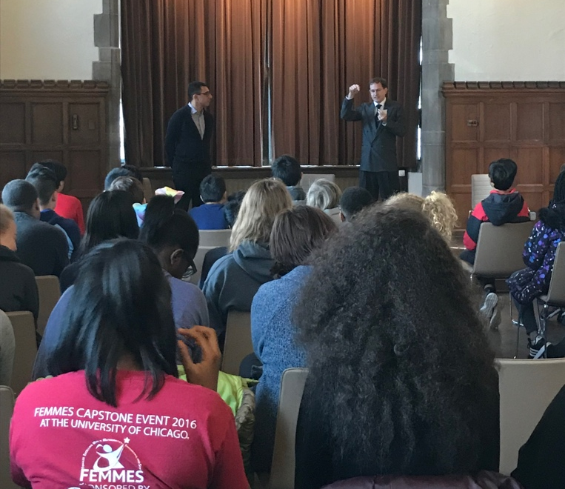
Engineering Transdisciplinary Outreach Program in the Arts (ETOPiA)
NSF DMR-1720139
2018
Education/Outreach, Northwestern University MRSEC
Engineering Transdisciplinary Outreach Program in the Arts (ETOPiA) is a Northwestern University MRSEC education and outreach program that uses theater and film media to inspire a cross-disciplinary dialogue about the role of science and technology in society and to highlight some of the ethical and moral implications of scientific and technological progress. ETOPiA has recently expanded beyond Northwestern University, featuring a Spring 2018 production of Copenhagen by Michael Frayn on both the Northwestern University and University of Chicago campuses. Students from the socioeconomically diverse Chicago Public Schools students were invited to attend matinee performances that were preceded by a discussion of the science and events relevant to the play, and were followed by a panel discussion with graduate students and tours of Northwestern University MRSEC facilities.
Chicago Public School students participate in a discussion of the science and events relevant to Copenhagen before the matinee performance at Northwestern University.

