Slide 1
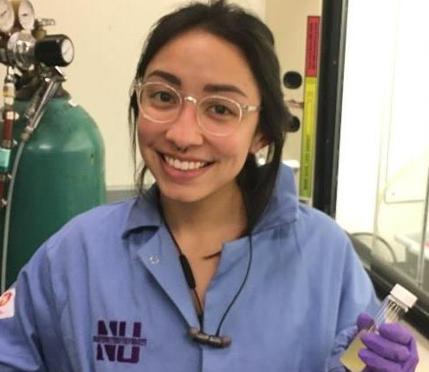
Research Experience for Undergraduates Plus (REU+)
NSF DMR-1720139
2019
Education/Outreach, Northwestern University MRSEC
The new NU-MRSEC REU+ Program enables select REU participants from small colleges to follow their summer experience with an academic quarter at Northwestern University as domestic exchange students, thereby allowing them to experience the rigor of an R1 university in a nurturing environment. REU+ students take classes and also continue their research for an additional ten weeks. This program creates a bridge to graduate study at Northwestern University or other research universities. In Fall 2018, the NU-MRSEC REU+ program was piloted with undergraduate student Monica Inouye from California State Fullerton, who successfully completed the Fall Academic Quarter at Northwestern University and was subsequently offered admission to the Materials Science and Engineering PhD program with financial support from the Northwestern University Graduate School.
Through the NU-MRSEC REU+ Program, Monica Inouye from California State Fullerton successfully converted an academic quarter at NU into admission to the Materials Science and Engineering PhD program.

