Slide 1
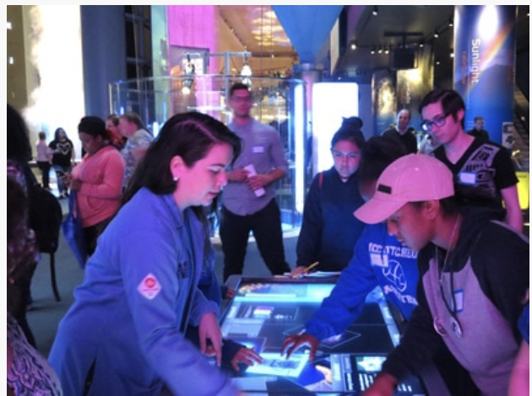
HerStory at the Chicago Museum of Science and Industry
NSF-MRSEC DMR-1121262
Education/Outreach, Northwestern University MRSEC
In collaboration with the Chicago Museum of Science and Industry, HerStory is an outreach event that encourages young girls, particularly underrepresented minorities, to pursue science in academia and beyond. The event agenda includes a massive scavenger hunt at the museum that featured exhibits of famous female scientists in each wing of the museum. Volunteers and young women from across the Chicagoland area participated in the event. The event also featured a lunch panel with scientists and graduate students sharing their own education and career experiences as well as their motivations for science and higher education.
Volunteers and attendees interact during HerStory at the Chicago Museum of Science and Industry.

