Slide 1
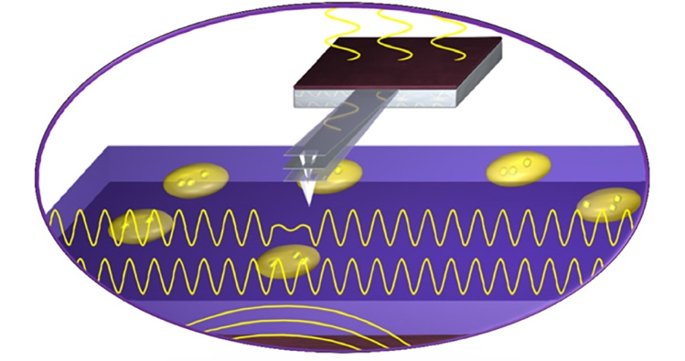
Facilities Development: Combined Ultrasonic and Scanning Probe Imaging
NSF DMR-1720139
2018
Shared Facilities, Northwestern University MRSEC
In addition to providing access to state-of-the-art commercially available instruments, the Northwestern University MRSEC Shared Facilities also participate in the development of new experimental methods and tools. In particular, the Ultrasound Bioprobe has been developed that combines the noninvasive nature and sensitivity of ultrasound waves with a near-field atomic force microscope mechanical probe that provides high phase sensitivity and mechanical contrast of the scattered ultrasound wave. This instrument enables high subsurface phase sensitivity under physiological conditions and nanomechanical imaging of subcellular structures. In addition to biological specimens, nondestructive subsurface imaging can be performed on other systems such as polymeric and semiconductor materials.
Schematic illustration of the Ultrasound Bioprobe. Customized piezo-transducers underneath the sample and the cantilever provide the flexural vibrations. The atomic force microscope mechanical probe detects the subsurface mechanical contrast.

