Slide 1
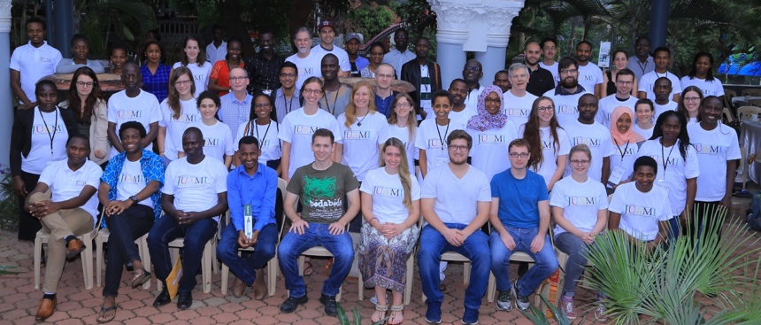
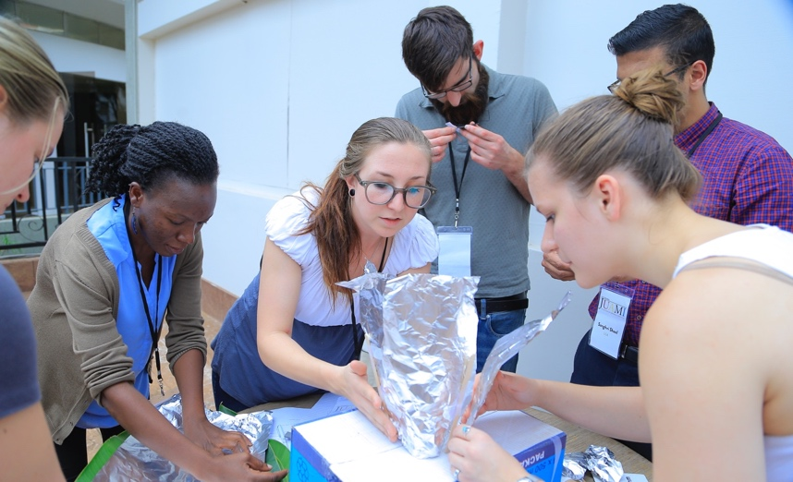
Joint Undertaking for an African Materials Institute (JUAMI)
NSF DMR-1720139
2019
International Outreach, Northwestern University MRSEC
Both developed and developing nations share the consequences of energy and resource utilization in a technologically advancing world. This shared fate creates opportunities for mutually beneficial collaborations, especially in the area of materials science, which underpins a broad spectrum of new technologies. With this understanding, the NU-MRSEC has supported Joint Undertaking for an African Materials Institute (JUAMI), which is the largely NSF-funded program aimed at fostering connections between young researchers in the US and those in Eastern Africa. JUAMI held its third advanced studies institute in Kampala, Uganda on December 9-20, 2018, in partnership with Makerere University. JUAMI brought together 24 US students from 18 US universities and 35 African students, primarily from the Sub-Saharan countries of Tanzania, Kenya, Uganda, and Ethiopia. Supplies provided by the NU-MRSEC were used in hands-on activities. These mini-labs were identified in post-program assessments as the most valuable component of the two-week program. The interactive environment resulted in 81% of the participants successfully identifying an international research collaborator.
JUAMI brought together 24 US students and 35 African students to foster international cooperation in materials science and engineering.

