Slide 1
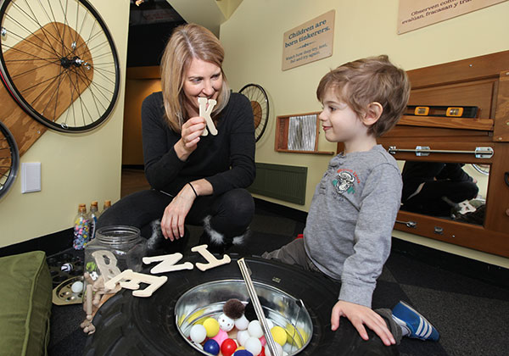
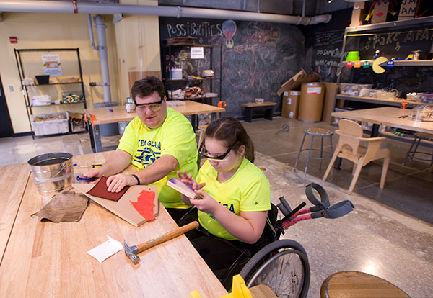
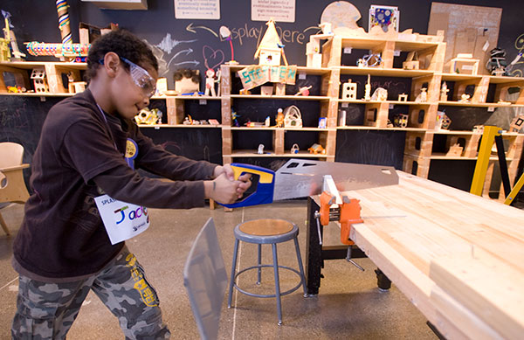
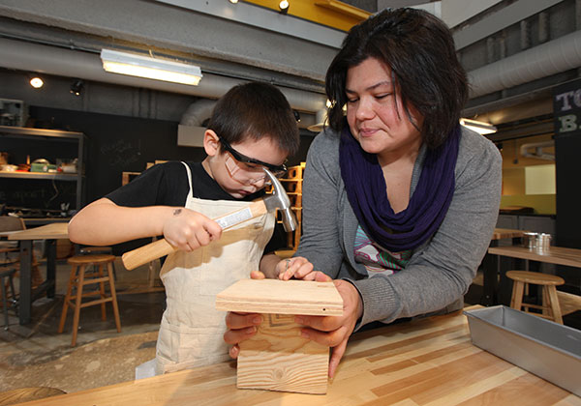
Tinkering Lab @ Chicago Children’s Museum
NSF-MRSEC DMR-1121262
Northwestern University
The Center collaborated with the Chicago Children’s Museum in prototyping and formative evaluation of the new permanent exhibit, Tinkering Lab, which focuses on the self-guided exploration of materials for K-8 students. The exhibit consists of a Tool Bar where professionally trained staff is available to assist when using tools that need extra supervision. During the reporting period, the exhibit served 400,000 visitors, including significant participation from the primarily underrepresented minority serving Chicago Public Schools.
Notes:
The Center collaborated with the Chicago Children’s Museum in prototyping and formative evaluation of the new permanent exhibit, Tinkering Lab, which focuses on the self-guided exploration of materials for K-8 students. The exhibit consists of a Tool Bar where professionally trained staff is available to assist when using tools that need extra supervision. During the reporting period, the exhibit served 400,000 visitors, including significant participation from the primarily underrepresented minority serving Chicago Public Schools.

