Slide 1
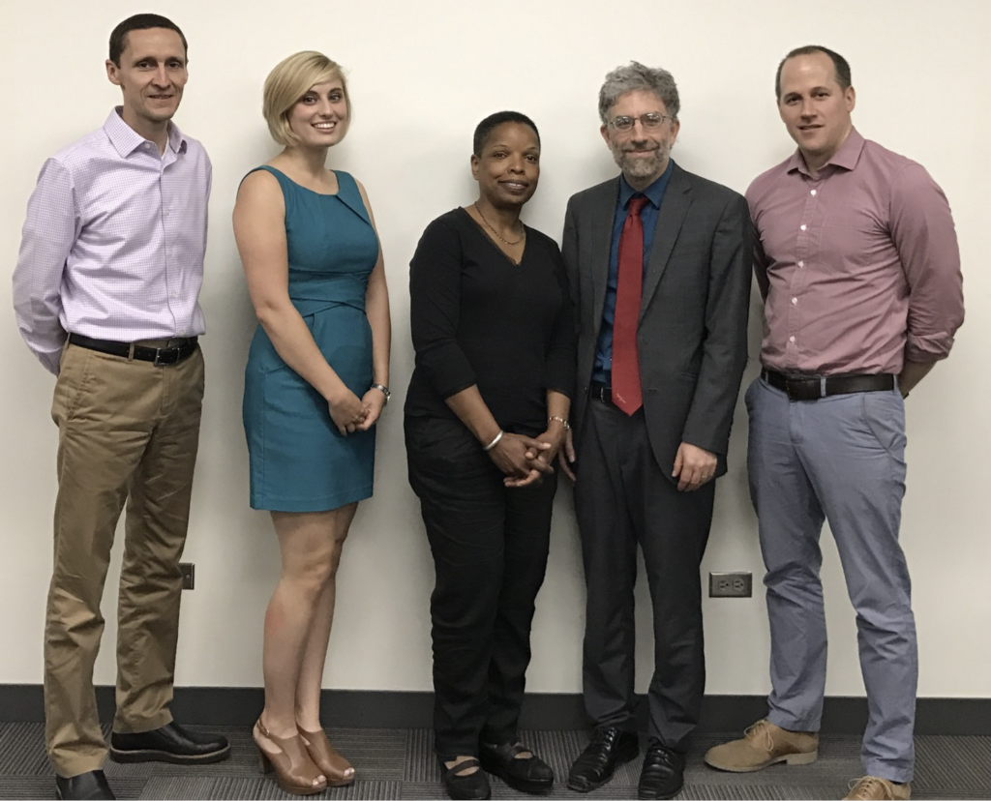
Research Experience for Teachers
NSF-MRSEC DMR-1121262
Education/Outreach, Northwestern University MRSEC
Since its inception in 1992, the NU-MRSEC has offered the Research Experience for Teachers (RET) program each summer to middle-school, high-school, and community-college teachers with the principal goals of engaging them in research, developing a network of scientific colleagues, learning about new scientific and technological developments, and transferring this knowledge to the classroom. Concurrent with their summer research, teachers develop a related curriculum project to be implemented in their classrooms and shared with colleagues and administrators. Former participants have also written proposals to support new curricula. These efforts include a course in nanotechnology taught at Lane Tech High School (Chicago Public Schools) with four NU-MRSEC guest lecturers.
Research Experience for Teachers (RET) participants with the RET Program Director, Professor Lincoln Lauhon (left).

