Slide 1
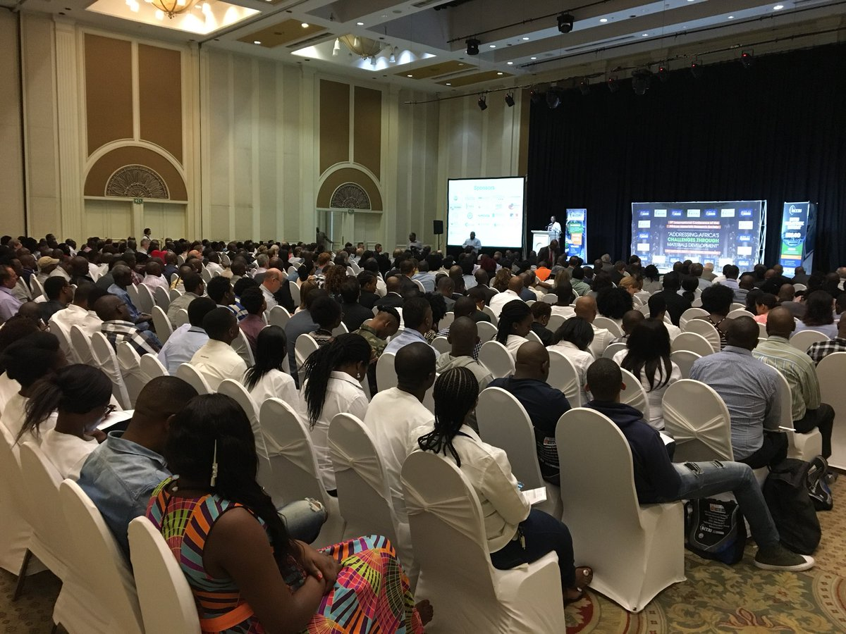
International Conference of the African Materials Research Society
NSF DMR-1720139
2018
International Outreach, Northwestern University MRSEC
The Northwestern University MRSEC supports a diverse suite of international collaborations and outreach activities. For example, the Center provided support for 10 students and postdoctoral research associates to attend the 9th International Conference of the African Materials Research Society (AMRS) on December 11-14, 2017 in Gaborone, Botswana. The themes of AMRS 2017 reflected both the needs of the global research community such as energy and health, as well as materials-centric issues that are specific to Africa. Overall, AMRS 2017 was attended by approximately 500 participants. This activity built upon the Joint U.S.-Africa Materials Institute (JUAMI) that aims to foster collaborative materials science research and education between Africa, the United States, and other international partners.
AMRS participants attend a plenary talk by Nobel Laureate Jean Marie Lehn in Gaborone, Botswana, entitled “Addressing Africa’s Challenges through Materials Development.”

