Slide 1
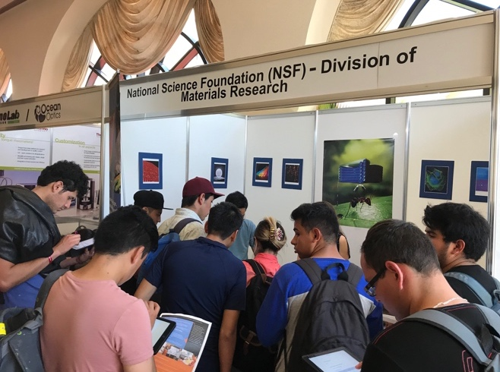
NSF-MRSEC Booth at the International Materials Research Congress
NSF DMR-1720139
2019
International Outreach, Northwestern University MRSEC
The NSF-MRSEC booth was featured at the XXVII International Materials Research Congress (IMRC) in Cancun, Mexico on August 19-24, 2018 to increase awareness, promote international collaboration, and broaden participation from traditionally underrepresented groups in the National Science Foundation Materials Research Science and Engineering Center (NSF-MRSEC) program. The annual IMRC is a joint effort of the Materials Research Society and the Socieda Mexicana de Materiales that helps promote leading-edge materials research globally. The NU-MRSEC led the effort and was joined by the UChicago-MRSEC, UCSB-MRSEC, and NYU-MRSEC. The NSF-MRSEC booth attracted 246 IMRC attendees, primarily from Latin America.
The NSF-MRSEC Booth at the XXVII International Materials Research Congress (IMRC) in Cancun, Mexico on August 19-24, 2018 attracted 246 attendees, primarily from Latin America.

